Slide 1
Club Matters
Jo Mannion & Lisa McCormick

Slide 2
Committee

Slide 3
General guidance
Work as a team! It will make life a lot easier.
Assign roles and make sure everyone know what is expected of them!
Meet regularly! Why not get meeting dates in the diary now?
Deal with issues quickly and directly. Don’t let things fester!
Keep in regular contact with the Sports Office.
Don’t be afraid to ask for help!
Be realistic!

Slide 4
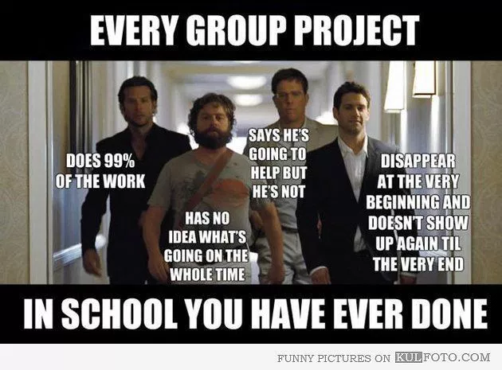
Activity
Turn to page 8 in your handbook and complete the table with the names of those on your committee who will be undertaking each role.

Slide 5
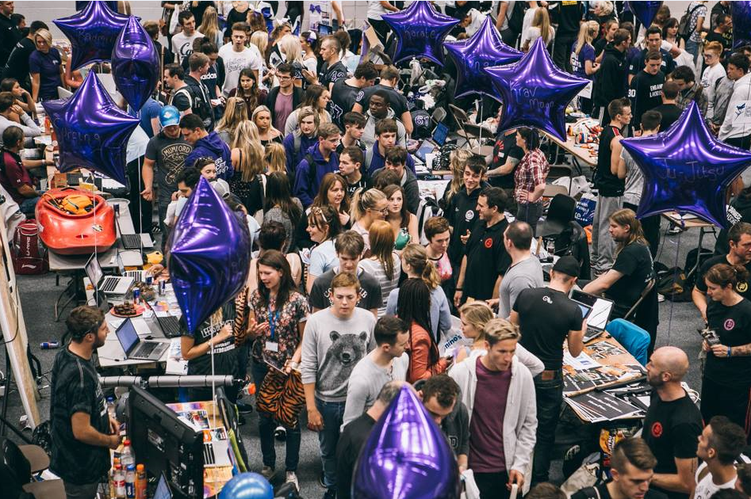
Fresher’s Fair
Notes:
This is what fresher’s are faced with...its dauting, its busy, its hot!

Slide 6
Fresher’s Fair Top Tips
Bring a tablecloth/bed sheet!
Make your stall bright, interesting, eye-catching
Make sure that everyone at your stall is actively doing something...if they’re just sat talking...do they need to be there?
Be welcoming - invite people to talk to you
Have handouts/freebies - how will they remember you when they leave?
Sell your club - trophies, videos, merch
How will you take sign ups?

Slide 7
Fresher’s Fair Details
Wednesday 21st September
Arena/Blue Hall
10am-4pm
Green Hall - Demo Zone
Set up in the hall for 9.30am please!
If you have any printing you want us to do this can be done on A5 paper only. Templates to be sent to Lisa by Monday 19th at the latest.

Slide 8
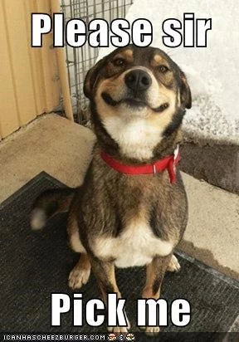
Trials/Tasters
‘Trial/Taster fees’ are not allowed.
Speak to the sport office if your trial/taster incur a cost e.g officials, facilities we can look at covering this.
Double check your facilities are booked!
Let the Sports Office know when trials/tasters are and what the structure is!
Make sure trials/tasters and sign up info is well advertised - give everyone the best opportunity to attend!
Give everyone a fair chance!
Give everyone the best experience they can have!
Don’t overbook sessions, spread them out!

Slide 9
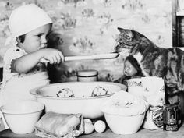
Trials/Tasters
If you struggle for numbers consider visiting other trials/speaking to other clubs to scoop up!Can you link to a Social?
Be clear when and where you will announce who's been successful.
Give feedback if asked . . PROMPTLY!
Follow up on non-attendees/drop-offs.
Redirect unsuccessful candidates to;
Other AU clubs
Intramural
USA Sports programme
Rackets Sports Programme
Keep their contact details you might need them at the end of the season!
If you need to do tasters/trials after Varsity let the Sports Office know.
Tasters/Trials last a moment, membership is forever!

Slide 10
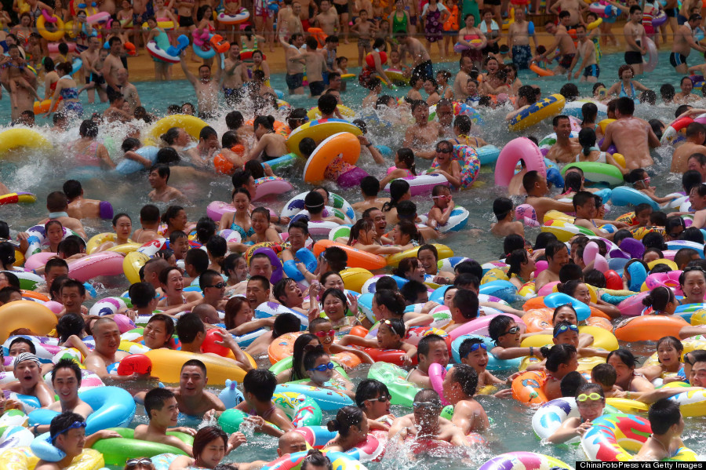
Facility Bookings
Our facilities are very full!
AU clubs get over 250 hours of dedicated training each week.
Last year in 1 week 47.5 hours were missed, that equates to £5434.50 in lost revenue
We will be doing regular check!
2 STRIKES
6 week ban!
Please let the Sports Office/Reception know ASAP if you can’t make a booking so someone else can use it!
Constant offenders will have bookings removed permanently.
Bookings start on the hour where possible to avoid ‘dead space’!
We’re understaffed!
Please help staff with set-up/clear-away, you’ll get started quicker!

Slide 11
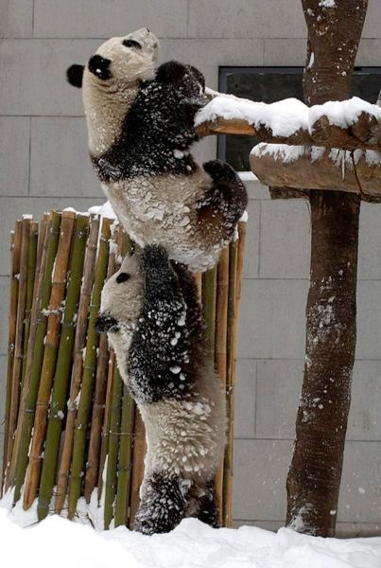
Special Measures
There to support clubs who are struggling not to punish.
Criteria:
Negative student account
Membership below 12 for more than a year
Substantial lack of engagement from Club Members
Serious anti-social behavior issues
Club will be notified they’re in special measures.
Monthly meetings with sports office.
Plan of action
12 months to get out of ‘Special Measures’
Failure to do so may mean:
Removal of Club Officers
Suspension of financial accounts
Dispansion of Club

Slide 12
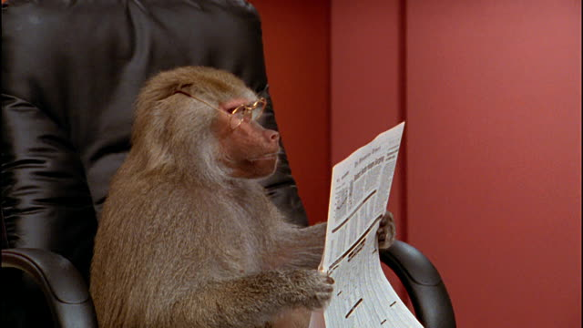
AU Newsletter

Slide 13
Competitions
Everything you need to know.

Slide 14
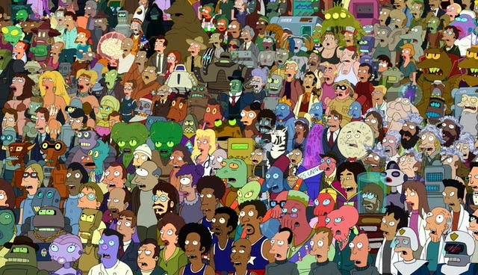
Why do we compete in Non-BUCS competition?
Notes:
Cater for a diverse audience
Its great for attracting new students and therefore great for attracting new athletes
Increases your employability
It’s good for you!

Slide 15
First Aid
Every team should have a first aid bag
If you don’t you can get one from the Sports Office.
It is recommended that each team has a trained first aider for away fixtures
Coach Ed course - 8th October!
First Aid at Home Fixtures - provided by Sports Centre Staff - Ambulance Procedure
If an injured player has to be taken to hospital a member of the team should always accompany them. Keep the Sports Office informed.

Slide 16
Competitions
Plan how many competitions can you physically and financially enter?
Tell us when & where they are
Check entry deadlines - if we are covering the cost we will need to pay this. If it is by invoice it takes 28 days to process!
If you need to host home fixtures here - can we accommodate? Speak to Lisa to book.
Notes:
We don’t have a one stop shop for all competitions - let us know when your competitions are and we can promote your team and your results
This also helps with transport bookings
If possible give us a fixture list - let us on fixtureslive
Payment of competitions

Slide 17
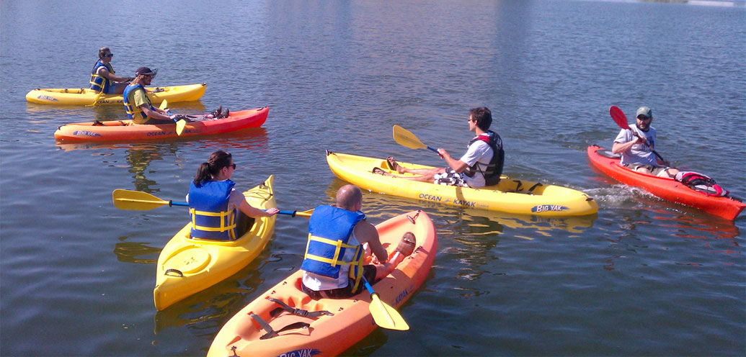
Fixtures
Plan, Plan, Plan!
Notes:
Make sure you consider:
Exams
Holidays
Christmas
Placement
Residentials
You need to be able to fulfill your fixtures

Slide 18
Results
Where possible let us know your results - we can help promote good news stories.
Either text them to 07825010379 or tweet us @carnegiesport
It also helps at Sports Awards as
we know your achievements!

Slide 19
Rules & Regs
You need to know the Rules and Regs for your Sport.
Including any facility/kit requirements
If you’re unsure or need help deciphering NGB jargon let us know!

Slide 20
Teamsheets
Why? - so we can check memberships and ensure player eligibility.
A copy of your teamsheet/participant list must be given to the Sports Office for every fixture/competition.

Slide 21
Conduct
Respect the officials/coaches/visiting players - no matter what.
Ensure buses are left clean and tidy
Alcohol on buses should be at the driver's discretion - if they don’t allow it. Don’t take it!
Player conduct - if you are fined you will be liable for the cost.
If you are on the receiving end of poor conduct… tell us!
Notes:
Mention last years example - one more bad report from a bus driver - alcohol ban
Social behaviour policy - everyone signs

Slide 22
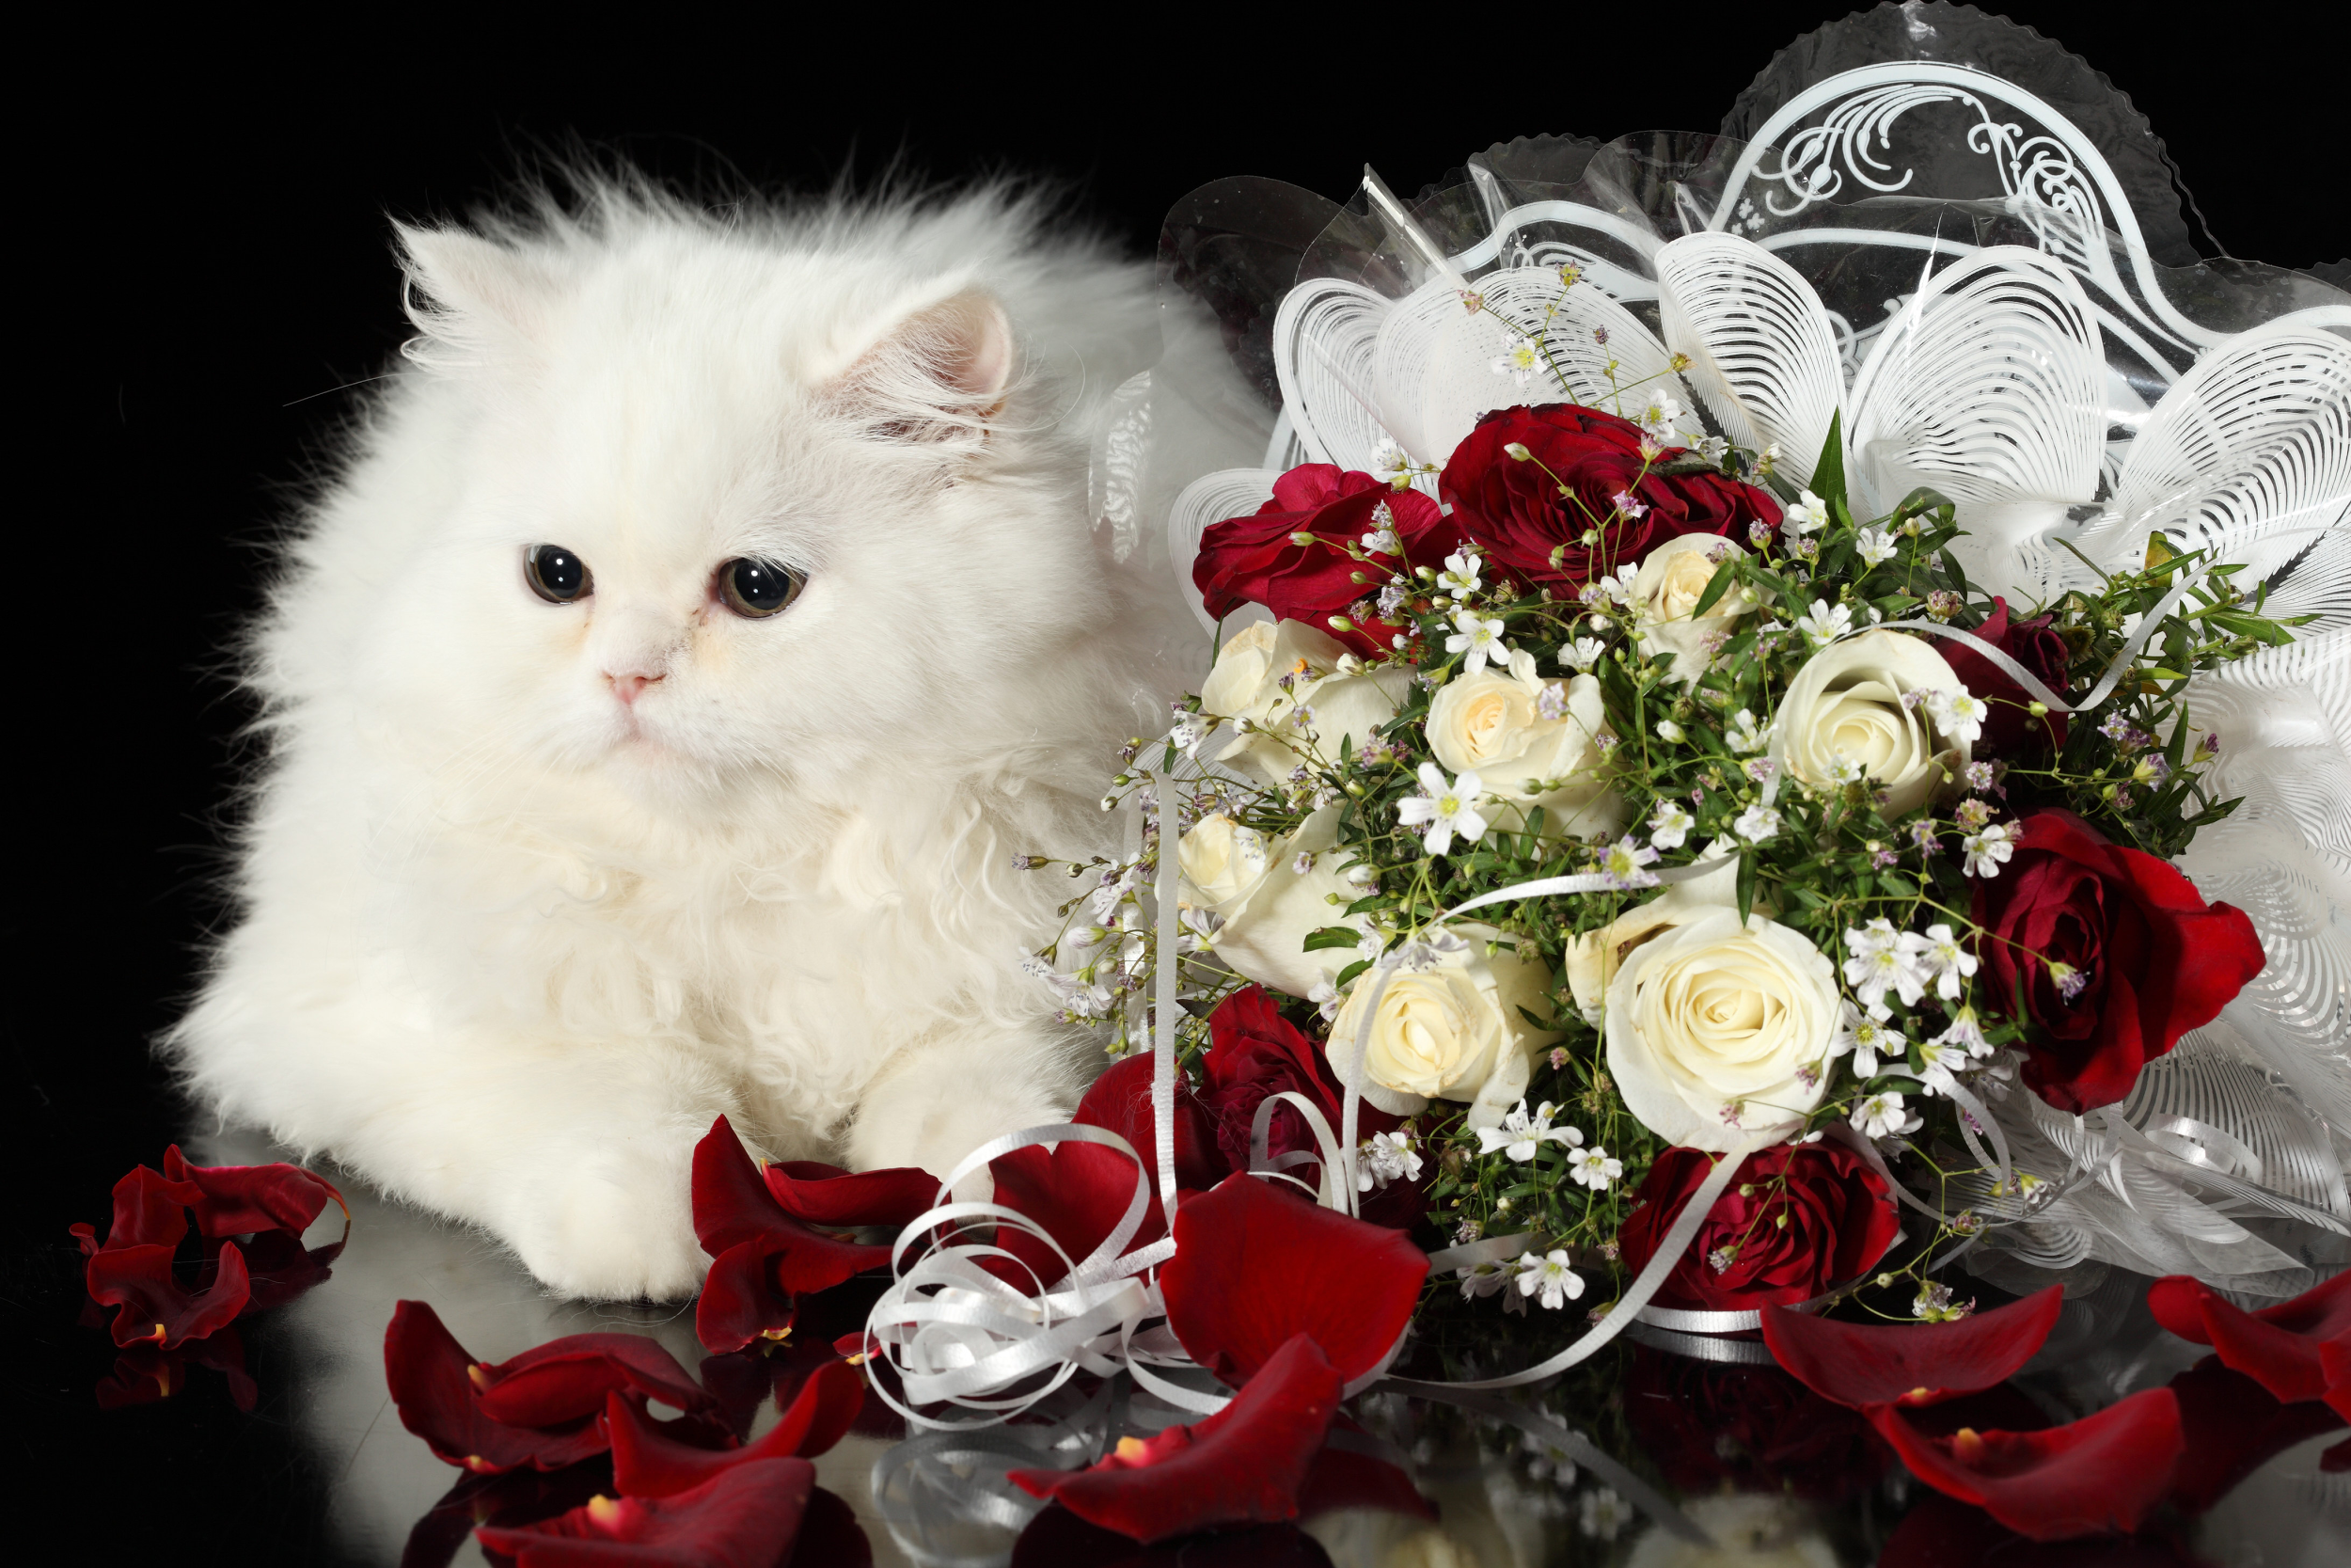
War of the Roses!

Slide 23
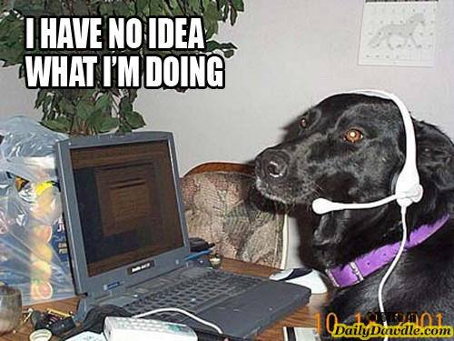
Scenarios . . .

