Slide 1
Non-BUCS Competitions
Everything you need to know

Slide 2

Competitions
Plan how many competitions can you physically and financially enter?
Tell us when & where they are
Check entry deadlines - if we are covering the cost we will need to pay this. If it is by invoice it takes 28 days to process!
If you need to host home fixtures here - can we accommodate? Speak to Lisa to book your facility before confirming your fixtures.
Transport & Accom
Notes:
Make sure you consider:
Exams
Holidays
Christmas
Placement
Residentials
You need to be able to fulfill your competitions - withdrawal costs money!

Slide 3
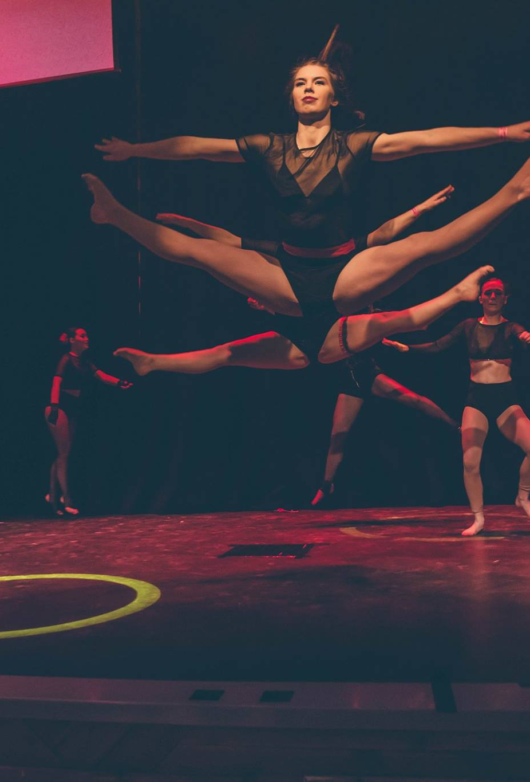
Rules & Regs
You need to know the Rules and Regs for your Sport.
Including any facility/kit requirements
If you’re unsure or need help deciphering NGB jargon let us know!

Slide 4
Teamsheets
Why? - so we can check that your members are insured to play (i.e. do they have a membership).
A copy of your teamsheet/participant list must be given to the Sports Office for every fixture/competition.
You can submit this via email, WhatsApp, Text or in person.

Slide 5

Conduct
Respect the officials/coaches/visiting players - no matter what.
Ensure buses are left clean and tidy
Alcohol on buses should be at the driver's discretion - if they don’t allow it. Don’t take it!
Player conduct - if you are fined you will be liable for the cost.
If you are on the receiving end of poor conduct… tell us!

Slide 6

Results
Where possible let us know your results – we can help promote good news stories.
Either text them to 07825 010379 or tweet us @CarnegieSport
It also helps at Sports Awards as we know your achievements

Slide 7
First Aid
Every team should have a first aid bag
  If you don’t you can get one from the Sports Office.
It is recommended that each team has a trained first aider for away fixtures
  Coach Ed course - 6th October!
First Aid at Home Fixtures - provided by Sports Centre Staff - Ambulance Procedure
If an injured player has to be taken to hospital a member of the team should always accompany them. Keep the Sports Office informed.
Concussion protocols
  – please inform us of head injuries

