Slide 1
Club Officer Training Day
Wednesday 16th May

Slide 2
The Sports Office

Slide 3
Meet the team
Daniel Stanley
Jo Mannion
Linda Bradshaw
Lisa McCormick
Craig Robinson
Kirsty McPhee
Dale Bottomley
Notes:
8 Staff Members

Slide 4
OUR VISION:
Great Culture. Great Experience. Great Opportunities.
WE AIM:
To develop all individuals to reach their sporting potential. To provide a welcoming and inclusive environment for every individual. To provide opportunities for individuals to develop personally and professionally. To provide every individual with an enjoyable and long-lasting experience. To strive to improve our service at every level based upon feedback from our customers.
WHAT WE OFFER:
ATHLETIC UNION
Performance
Competition
Participation
CAMPUS SPORT & FITNESS
Fitness Classes & Gym Provision
Tasters Sessions
Intramural Leagues
Events & Tournaments
DEVELOPMENT & EMPLOYABILITY
Coaching Bursaries
Sports Volunteering Programme
Referee Development
Sports Activator Programme
3
COMMUNITY & JUNIOR PROVISION
Sports Camps
Junior Sports Academies
School Partnerships
External Customers
0

Slide 5
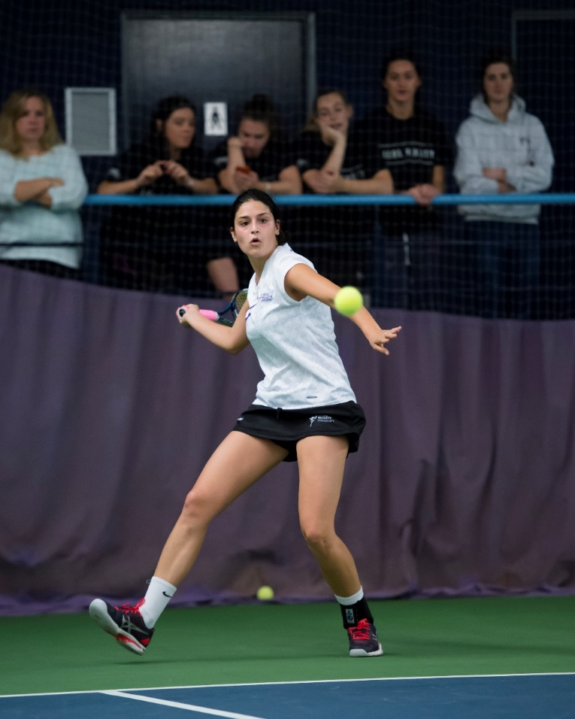
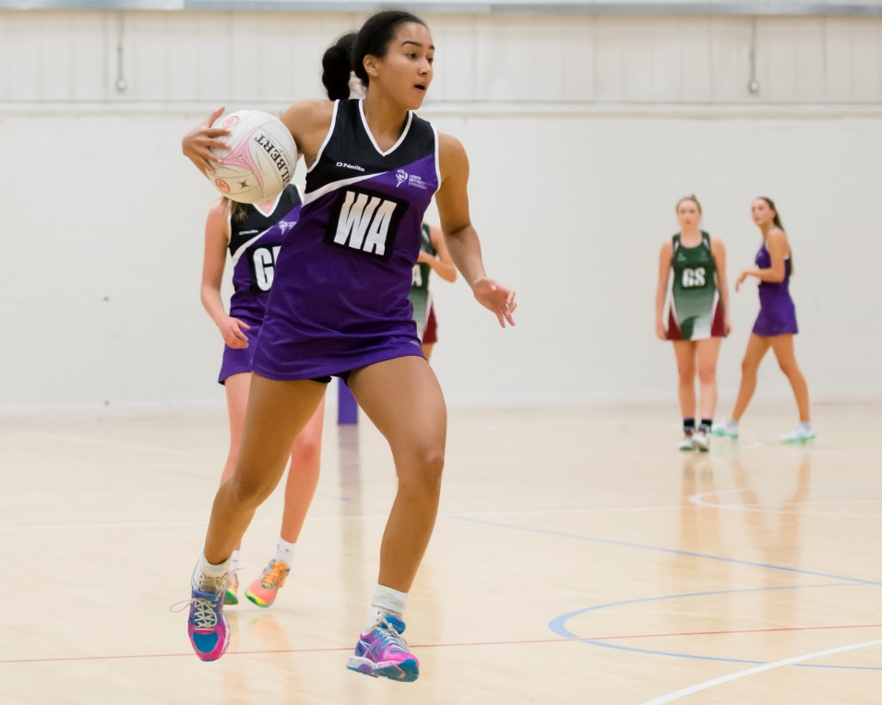
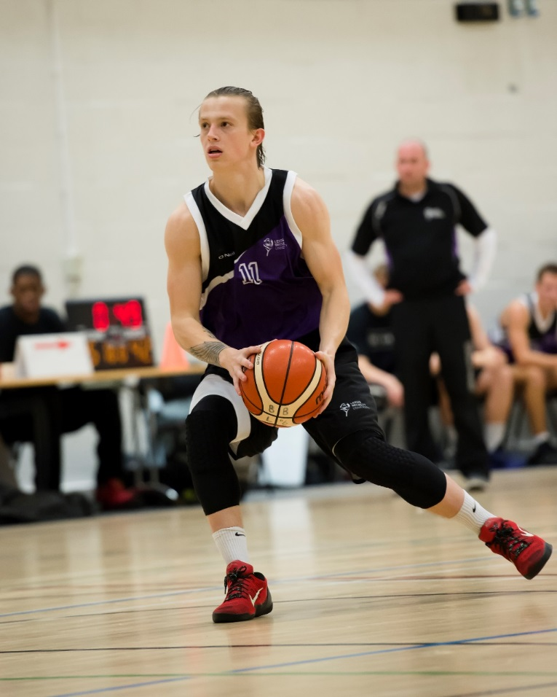
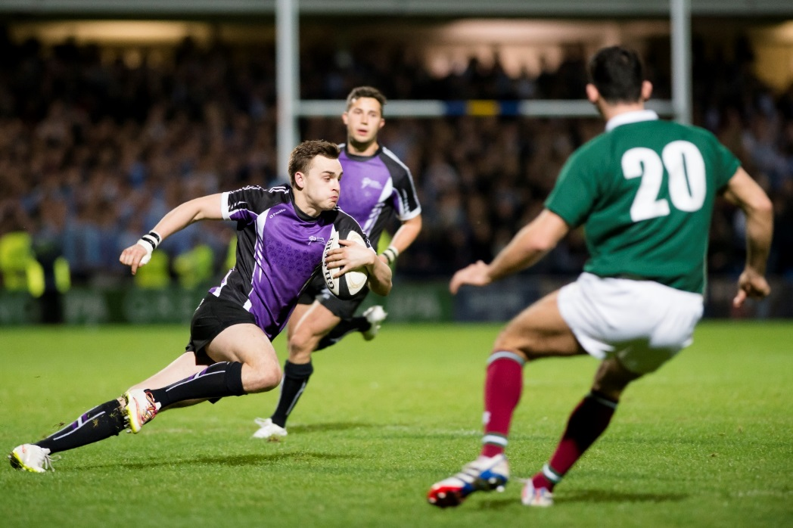
Kit

Slide 6
Playing Kit
Majority of teams have the O’Neills Playing Kit (some exceptions)
Purchasing additional or customised kit:
Speak to CDA
Confirm items to be ordered
Collate kit sizes and payments (this can be done through the office)
Place the order with CDA who will confirm a delivery date
2-3 week turnaround
Notes:
Where O’Neills are unable to supply we can look elsewhere.
Cheerleading
Gymnastics
American Football

Slide 7
Leisurewear
Can be bought individually online
OR
Club orders can be placed with the CDA.
Can customise with sponsor logos and initials
Same process as the playing kit order
8-10 week turnaround

Slide 8
Any Questions?

Slide 9
Groupings
Group 1 (JGG03)
Group 2 (PRIG04)
Group 3 (PRI G11)
Baseball
Cheerleading
American Football (M&W)
Football (W)
Netball
Volleyball
Badminton
Boxing
Dance
Handball
Rugby Union
Tennis
Hockey (M)
Lacrosse (M)
Gymnastics
Korfball
Lacrosse (W)
Tchoukball
Futsal

Slide 10
Expectations of a Club Officer
Lisa McCormick

Slide 11
Why are you here?
You were voted in!
You have the skills needed to lead your club over the next 12 months
You want to make a difference in your club!
You want to put something fantastic on your cv (other than your degree)
You have a lot of influence over your peers
Notes:
Ask the question?
What does being a club officer mean to them?
Mention about registering with the Sports volunteering programme?

Slide 12
What we Expect of you?
Respond to emails/communications promptly (48 hours)
Engage with us
Talk to us – if you are struggling… tell us!
Take responsibility for the , recruitment activity and actions of your club (good and bad)
Make us aware of any issues or incidents immediately
Manage your finances and don’t contravene any university regulations
Be a positive example to the rest of your club members
Share information with your club members
Notes:
Ask what they think we expect of them
Refer to the code of conduct for a full list

Slide 13
What you can expect of us
Training
Answer enquiries within 48 working hours; Endeavour to reply all emergency enquiries within 2 hours.
Support with CDPs, Recruitment and Fundraising
Deal with Disciplinary Issues Consistently and fairly.
Club Admin Support – Transport, Fixtures, Accommodation, Financial
Handle club datA in accordance with GDPR regulations
Monitor the official social media accounts of all Clubs and alert Club Officers to offensive content that must be removed.
Forward any enquiries from prospective members to Club Officers to respond.
Notes:
Ask what they think we should be doing?
Staff will not:
Make a payment out of the Student Account that has not been signed off by 2 members of the AU Club
Be responsible for planning or running Club’s events, recruitment or promotions.

Slide 14
Committee Communication
Notes:
How are you going to communicate between the committee; with the club; with new students; with the AU?
What ways are best to communicate?

Slide 15
Conflict Resolution
Notes:
During your term as a club officer you will have some issues within the committee and within the club. You have to be able to identify them and solve them.
Don’t leave it until the end of the year
How can you diffuse a situation
Activity – 2 mins – issue with a fellow committee member not pulling their weight

Slide 16
Resolving Conflict
TALK!
Discuss the problem
Speak to the Sports Office for advice
Is there a compromise to be made?

Slide 17
General guidance
Work as a team! It will make life a lot easier.
Assign roles and make sure everyone knows what is expected of them.
Meet regularly. Why not get meeting dates in the diary now?
Deal with issues quickly and directly. Don’t let things fester
Keep in regular contact with the Sports Office.
Don’t be afraid to ask for help
Be realistic!

Slide 18
The Technical Stuff

Slide 19
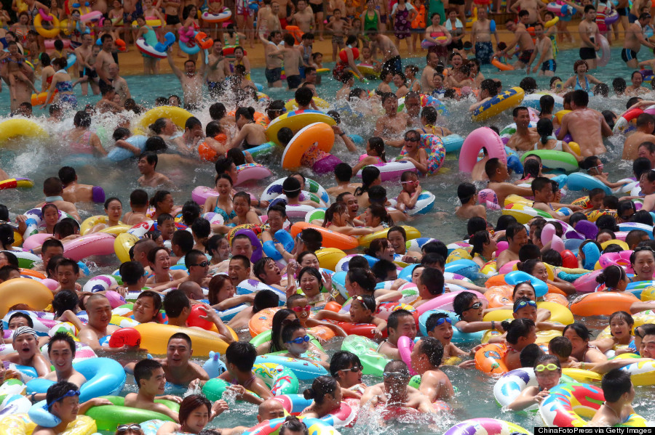
Facility Bookings
250 hours of dedicated training each week.
We will be doing regular checks
2 STRIKES
6 week ban
Please let the Sports Office/Reception know ASAP if you can’t make a booking so someone else can use it!
Bookings start on the hour where possible to avoid ‘dead space’!
Your session should begin to wind down 10mins before the end time of your session.
Please help staff with set-up/clear-away, you’ll get started quicker!
Notes:
Constant offenders will have bookings removed permanently.

Slide 20
Special Measures
Criteria:
Negative student account
Membership below 12 for more than a year
Substantial lack of engagement from Club Members
Serious anti-social behavior issues
Club will be notified they’re in special measures.
Monthly meetings with sports office.
Plan of action
12 months to get out of ‘Special Measures’
Failure to do so may mean:
Removal of Club Officers
Suspension of financial accounts
Dispansion of Club
Notes:
There to support clubs who are struggling not to punish.

Slide 21
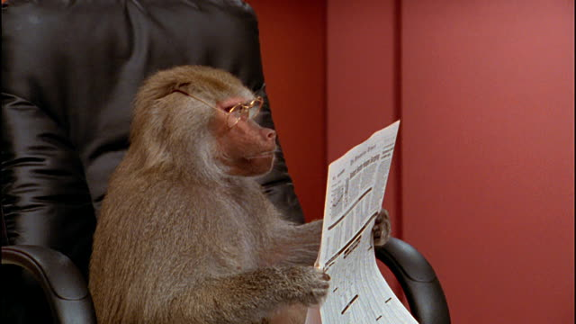
AU Newsletter
Notes:
Use it, sent out to all AU Members
Fundraisers, new articles.

Slide 22
AU Exec
Do you fancy the opportunity to represent the views of 41 Clubs, 1500 members at important council meetings and conferences?
Great CPD Opportunities
Refund on your Sports Membership/AU Membership at the end of the year
Free hoody
Free Varsity Ticket
Free Sports Awards Ticket
Register your interest with Lisa – voting opens over summer

Slide 23
Code of Conduct
Two copies to be signed by each Club officer
You keep one, we keep one

