Slide 1
Accommodation, Finance & Transport
Club Officer Training
September 2018

Slide 2
Linda Bradshaw Athletic Union Administrator

Slide 3
Accommodation
Who, Where, When, How long?
Leeds Beckett University allocates £10 per person per night. If accompanied by a coach the University will pay their room charge.
When considering a booking please remember, male/female numbers any special requirements and be specific, with locations. Forward plan for big events i.e. Swimming – every University in the UK are going to the same place at the same time!
Athletic Union Office, will email with costs, cancellation dates, no booking will be made without confirmation back! Price may increase if you delay!
All other costs to be met by the students involved and must be paid into the Sports Office before departure, and paperwork signed off. Confirmations will then be sent.
Additional requests breakfasts, evening meals can be booked but all at student expense.

Slide 4
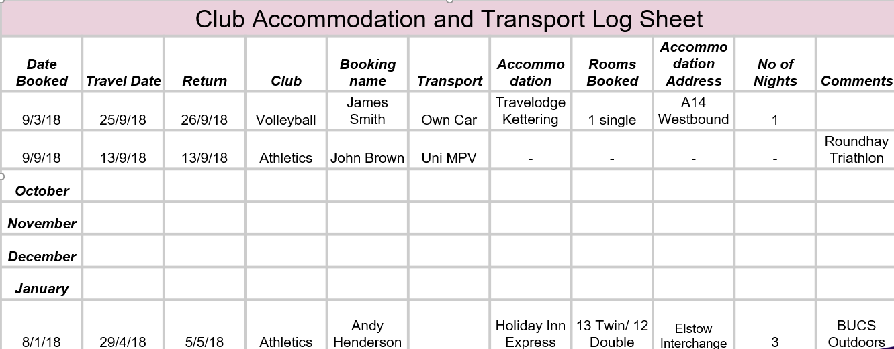
Accommodation

Slide 5
Finance
Paying a supplier
Speak to Sports Office prior to ensure approved supplier (via Invoice or Credit Card)
AU Student Expenditure Form
What transaction are you wanting to make?
Claiming personal expenses (Including fuel and travel)
Student Account
Paying Ref Fees Receipts must be returned before 12pm on the following day otherwise Clubs will be charged
Paying in Slip
Always obtain a receipt for your records
Online Deposits
Speak to Sports Office and obtain bank details
Reference with Club and Name
Email AU Administrator with date of transfer and amount & copy of form.
Paying in Money/Cheques
Buying a Second Membership

Slide 6
Finance Is the purchase from the Operational (University) or Student Account
Purchases
No purchases can be made from the Operational Account without the AU agreement.
Check account balance – Does your Club have the money!
Email 2 authorisations to the AU Office for the full cost, or physically come into the Office to sign.
Attach any invoices, quotes you may have.
Leave time, paperwork does need to be signed off!
Expenses
You cannot sign for your own expenses! You require 2 other signatures!
Fill in Blue Form, with your account details
Attach any receipts, invoices you may have.
Don’t use your own money, ask the Office, it can take up to 3 weeks to reimburse you!

Slide 7
Finance
All Student Accounts can be found on your Club Development Plan.
Accounts will be updated with all transactions on a weekly basis - by Friday of each week at the latest.
Do not agree to any purchases with a supplier, without checking with the AU Office initially.
Meetings can be set up at anytime with myself if you are unsure of anything, l.i.bradshaw@leedsbeckett.ac.uk

Slide 8
Transport
No payment will be made for any transport not booked through the Athletic Union Office.
No reimbursements either through the Operational or Student Account will be made if any booking or cancellation made without prior authorisation with the Athletic Union Office, even in the case of bad weather.
All Wednesday Transport will be published with the Fixture Sheet on the Thursday prior to fixtures. If you are staying after the match let us know or tell the coach driver!
Any transport away from a Wednesday, where possible will be by coach, if not possible, cars, vans and larger vehicles up to 9 seats are available.
If you are asking any club members to drive, they must have at least 2 years driving experience and preferably be over 21 as the excess is lower. Forms must be completed before driving!
All fines, whether speeding or parking are the students responsibility not the University
Nine seat MPV’s the speed limit is 60mph not 70!
Students can use their own vehicles, if the vehicle is registered in the office, expenses are 20p a mile, with a VAT receipt.

Slide 9
Transport
Hire Vehicles
Due to building works where possible the hire companies will write on the key envelope where the vehicle is – please do the same for them when dropping off the vehicle!!
Before and after hire take photos where possible and keep in the short term of any damage- so we are not charged!
If an accident does occur can you please send in someone to fill out an accident form asap, most hire vehicles have CCTV, it is deleted very quickly.
If an accident or vehicle damage is deemed to be excessively negligent on the Clubs part, you will be charged.
Insurance Excess is £1000 for over 21’s and £1250 for under 21’s.

Slide 10
Any questions?

