Slide 1
LEEDS BECKETT UNIVERSITY
Differentiation: opportunities for all students to be challenged and to achieve their potential
Oliver Wilson and Kevin Deighton and Sue Smith
Notes:
T

Slide 2
What is it?
Why is it important?
What it is/is not
What might you recognise as differentiation?
Some examples in your School….

Slide 3
What is it?
Meaning
Differentiation is about knowing students’ capabilities and using that knowledge to support them to achieve in the best way they can. It is integral to student centred approaches to learning.
Tailoring instruction to each student’s learning style, readiness level and interest (Turner et al, 2017)

Slide 4
7 core principles
Essential material
Teachers respond to student differences
Critical thinking for individual growth
Collaborate and co-create
Diverse group work
Design sessions proactively to address variance
Resource
Chamberlin and Powers (2010)

Slide 5
What it is What it is NOT
An idea as old as effective teaching
At the core of quality teaching
Valuing and planning for diversity in different settings
A student focussed way of thinking about teaching and learning
Use of whole group, small group and individual tasks based on content and student needs
Tracking or grouping students by “ability”
Incompatible with standards
Dumbing down -teaching for some students
Individualised instruction
Mostly identified for students with learning challenges
Something extra on top of good teaching
Mostly for students identified as gifted

Slide 6
Why is it important?
It’s important in UK schools - where students on teaching practice are required to demonstrate differentiation in their lesson plans, teaching, feedback and assessment.
It’s important in UK HE - with tutors encouraged to be flexible in design, delivery and assessment in order to meet the needs of an increasingly diverse student body.
Notes:
T

Slide 7
What might you recognise as a differentiated activity….?

Slide 8
Two examples of differentiated activities from the School of Sport….

Slide 9
Journal club participation improves outcomes for undergraduate Sport & Exercise Science students.
Oliver J. Wilson and Kevin Deighton
School of Sport, Leeds Beckett University, Leeds, LS6 3QS, United Kingdom

Slide 10
"Oliver Wilson and Kevin Deighton's outline how integrating an inclusive journal club into the curriculum (with associated higher order questioning) improved students'critical appraisal skills and confidence when reading academic papers.”

Slide 11
Higher self-perceived critical appraisal skills and academic performance after journal club 2016
Self-perceived critical appraisal (0-7)
Module grade for physiology (%)
Wilson and Deighton (2016)
Values are median (IQR)

Slide 12
Rationale and purpose
Previous studies analysed journal papers in weekly or twice weekly seminars as part of their curriculum.
These did not include an (adequate) control group.
Greater self-perceived critical appraisal skills and academic achievement after our extra-curricular bi-weekly journal club vs. control group.
We tested whether journal club participation in a larger sample of students would improve objectively measured critical appraisal skills, attitudes to science and module marks relative to controls.

Slide 13
Methods
Opportunity presented to ~350 students
15 students completed all activities
15 students acted as controls
Completed the same modules within the curriculum
Critical thinking tests
Attitudes towards reading journal articles
Attitudes towards science
Module grades
9 x 1h journal club meetings

Slide 14
Higher confidence and lower negative emotions when reading journal articles for JC group
Values are mean (SD)

Slide 15
Improved attitudes towards science for JC group
Values are mean (SD)

Slide 16
Improved critical thinking test scores for JC group
Values are mean (SD)

Slide 17
Improved academic performance after journal club
Values are mean (SD)

Slide 18
Discussion
Improved confidence when reading journal articles may help to explain the reduced the stress and frustration when reading journal papers (Round and Campbell, 2013).
Improved critical appraisal skills agrees with previous curriculum-based studies (Hoskins et al, 2011; Phillips, 2009).
Increased positivity towards science and scientists suggests improvements in their understanding of the nature of science and whether scientific talent is innate (Hoskins et al, 2011).
Greater academic performance agrees with others (Hoskins et al, 2007; Round and Campbell, 2013) and suggests reaching higher levels of Blooms taxonomy.

Slide 19
Conclusion
Students’ confidence and objectively measured ability to critically appraise the primary literature was increased after journal club compared with controls.
This was associated with increased academic achievement relative to controls.
Guided analysis of the primary literature can be conducted successfully as an extra-curricular activity.
These findings support the integration of journal club into the curriculum.

Slide 20
Questions?
O.J.Wilson@leedsbeckett.ac.uk
K.Deighton@leedsbeckett.ac.uk

Slide 21
References
Hoskins, S.G Lopatto, D., & Stevens, L.M. (2011) The C.R.E.A.T.E. Approach to Primary Literature Shifts Undergraduates’ Self-Assessed Ability to Read and Analyze Journal Articles, Attitudes about Science, and Epistemological Beliefs. CBE-Life Sciences Education. Winter; 10(4): 368–378.
Hoskins, S.G., Stevens, L.M. & Nehm, R.H. (2007) Selective use of the primary literature transforms the classroom into a virtual laboratory. Genetics, July 176 (3), 1381-1389.
Phillips, A.C. (2009) Teaching critical appraisal to sport & exercise sciences and biosciences students. Bioscience Education, 14, 6.
Round, J.E. & Campbell, A. (2013) Figure Facts: Encouraging undergraduates to take a data-centred approach to reading primary literature. CBE-Life Sciences Education, 12, 39-46.
Tanner, K.D. (2012) Promoting student metacognition. CBE-Life Science Education, 11 (2), 113-120.

Slide 22
The 7 slide lecture.
Oliver J. Wilson

Slide 23
"​The 7 slide approach adopted by Dr Oliver Wilson in the School of Sport helps to improve students' deeper reading and analysis and critique of journal articles through a series of staged questions- thus contributing to a more differentiated approach to learning "

Slide 24
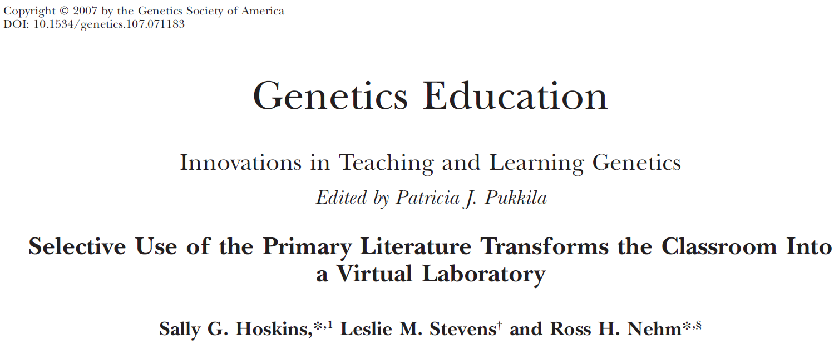
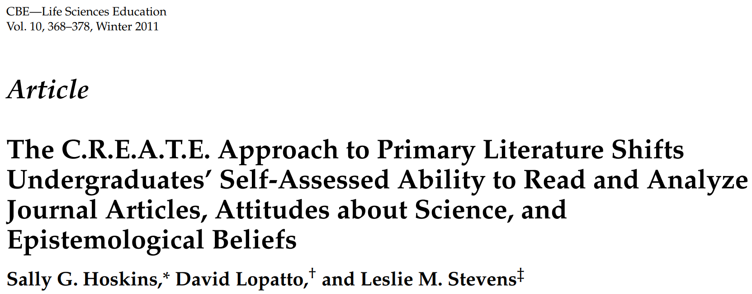

Slide 26
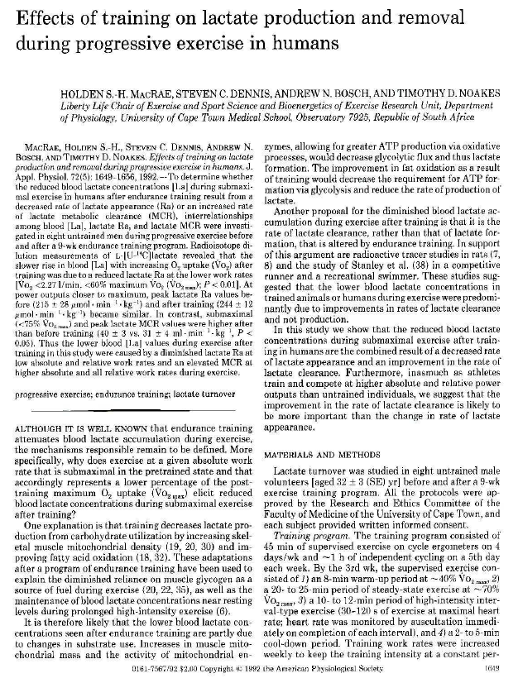
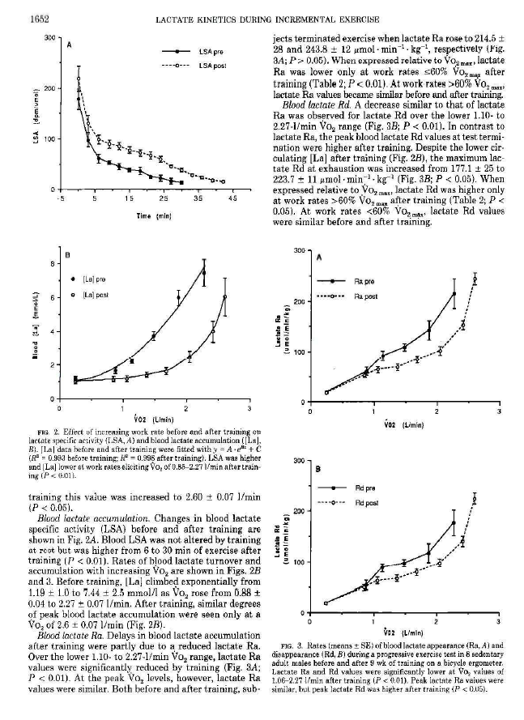
The 7 slide lecture
Selected an appropriate paper
Read the paper in detail to generate questions about Methods and Results
10 questions as part of differentiated learning and upload redacted article
Lower order cognitive skills building to higher order cognitive skills

Slide 27
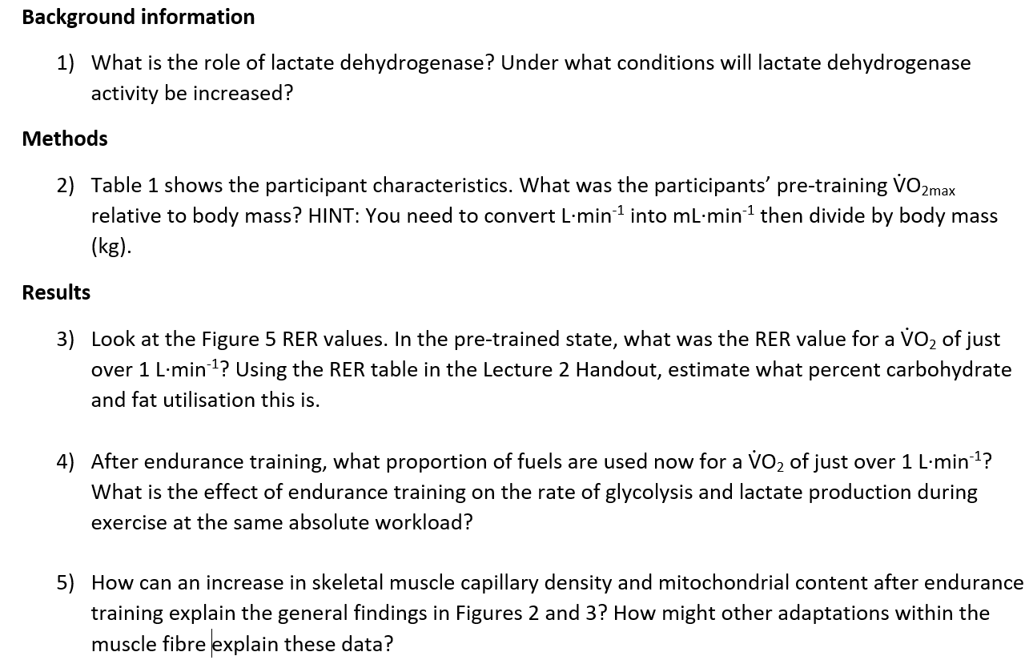

Slide 28
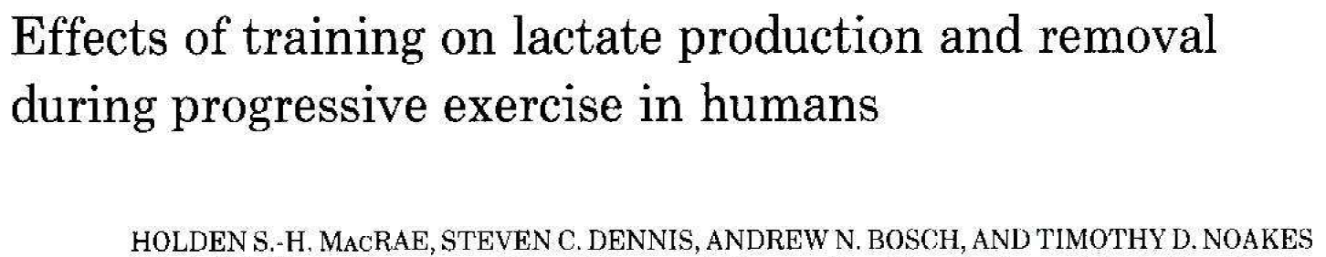

Slide 29
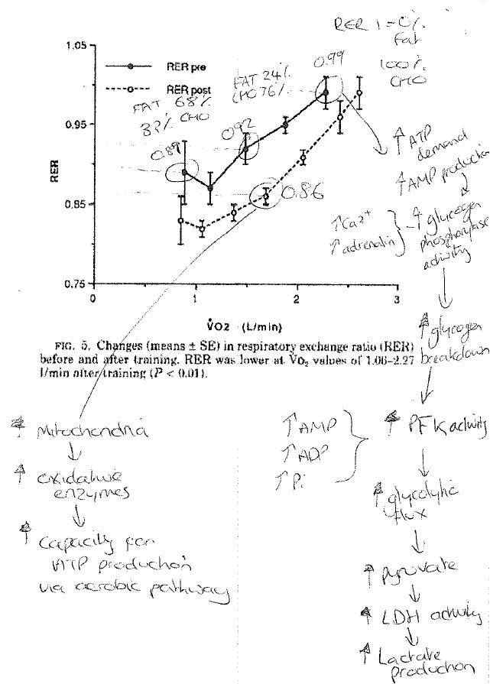

Slide 30
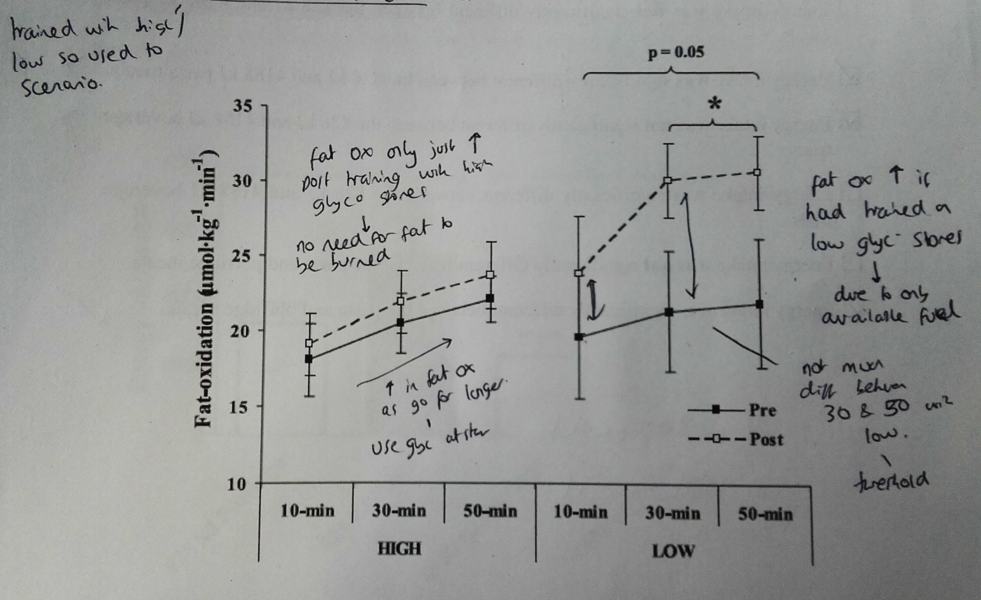
Example of a student’s pre-session annotated figure

Slide 31
Positives
I loved it.
Forced me to read papers more deeply.
Fast paced and lots of white board work.
Easy to hard questions is rewarded with students readily engaging and answering the questions.
Opportunity for many additional open questions.
Students rated it highly and voted to keep it.
70% attendance for 6 weeks in lectures.
Less work for me in preparing lectures.

Slide 32
Challenges
You have to know your onions.
I found the fast pace and ‘entertaining’ can be exhilarating but exhausting.
Panopto won’t capture the considerable white board work.
Limited revision material for the non-attenders.

Slide 33
Questions?
O.J.Wilson@leedsbeckett.ac.uk

Slide 34
Task and Discussion
What kind of things do you do already to enhance differentiation?
What works? What doesn’t?

Slide 35
References
Chamberlin, M., & Powers, M. (2010). The promise of differentiated instruction for enhancing the mathematical understandings of college students.Teaching Mathematics and Its Applications,29,113-139. doi:10.1093/teamat/hrq006
Dosch, M., & Zidon, M. (2014). “The Course Fit Us”:
Differentiated instruction in the college classroom.International Journal of Teaching and Learning in Higher Education, 26(3), 343-357.
Ernst, H. R., & Ernst, T. L. (2005). The promise and
pitfalls of differentiated instruction forundergraduate political science courses: Student and instructor impressions of an unconventional teaching strategy. Journal of Political Science Education, 1,
39–59.
Tomlinson, C. A. (2004) Sharing responsibility for differentiating instruction. Roeper Review, 26(4),188-189
Turner, W Solis O. and Kincade, D. (2017) Differentiating instruction for large classes in HE,International Journal of Teaching and Learning in Higher Education, 29,3,490-500.
Williams-Black, T. H., Bailey, J. P., & Lawson, P. D.
(2010). Differentiated instruction: Are university reading professors implementing it? The Reading Matrix, 10(1), 45-54.

