Slide 1
Staff Development 2016-17
Monitoring, Annual Review
& Enhancement
Quality Assurance Services

Slide 2
Flexible Framework
Our framework of monitoring and review encompasses:
continuous in-year monitoring
annual review
associated enhancement activity

Slide 3
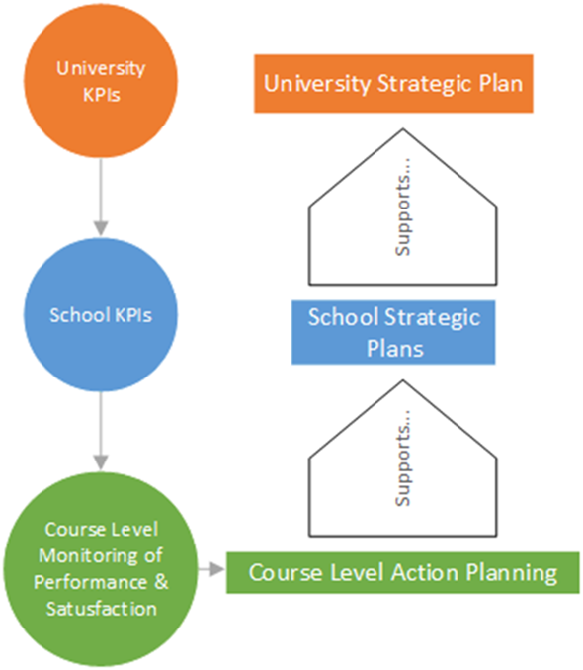
Purpose

Slide 4
Key features
Close alignment with KPIs (School/ University)
Empowerment of Academic Decision Making
Less burdensome
Different UG and PG reporting schedules
Continuous Course Log/ Action Plan
One (shorter) course level report template
Provision of clear, accessible data
Stronger partnership with student body
No annual quality reports at School/ Uni. Level – assurance reporting through the cycle

Slide 5
Course Level Monitoring, Review and Enhancement
Engagement with data, feedback and external quality indicators
Continuous Course Log/ Action Plan
End of cycle Executive Summary Report
Approval of modifications and External Examiner Report responses within specified timescales
At least one engagement opportunity with students each semester/ flexible course rep engagement
Enhancement updates on Course VLE – ‘Module & Course Group Communicator’

Slide 6
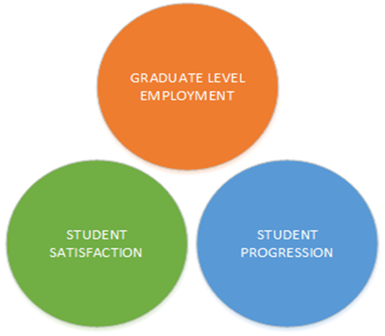
Engaging with Data

Slide 7
Student Satisfaction
Overall Satisfaction KPI: 88%
Teaching on my Course KPI: 89%
Assessment and Feedback no KPI
Learning and Resources KPI: 92%
Student Progression
KPI: 92%
Graduate Level Employment
KPI: 76%
School level KPIs will set performance expectations over the lifecycle of the strategic plan – Executive Summary reports will reference these
Final KPI outcome reports for each Course/ School shared with Deans each Sept/ Jan

Slide 8
Access to Monitoring Data
DATA DASHBOARD:
A KPI focused summary of survey & DLHE data
Progression rates & award outcomes
First sit and Re-sit information
Contact hours and assessment types for FT UG courses
Cohort profile
Notes:
Link to example of Dashboard report instead???

Slide 9
Course Log/ Action Plan
Live, multi-functional document – focus on actions
Records quality related activities & ACTIONS:
Student performance data analysis
Response to External Examiner Report/ feedback
Response to new benchmark statement
Response to student feedback
Can reflect School or Subject level exercises, eg NSS Working Group, Deep Dive enhancement projects, HEA PSFE objectives etc..
Brief entries with links to evidence/ fuller contextual resources, eg meeting minutes
Accessibility is key (shared drive or Google drive)
Notes:
Bring up example (instead)??

Slide 10
Executive Summary Report
Report summarises good practice and progress made against defined performance indicators.
Brief format with key statements of assurance.
Separate templates for UG and PG/ home and collaborative provision)
Oversight via SAC/ actions can be elevated to AQSC
New for 2016-17; Course Representative contributions
UG – completion by end of October
PG – completion by start of February
Notes:
Bring up examples (instead??)

Slide 11
Modifications
Scale-appropriate oversight at Course or School level
Competition and Markets Authority (CMA) – consultation and approval requirements
School level modifications deadlines:
Feb 17 for changes commencing Sept 17
Nov 17 for changes commencing Sept 18

Slide 12
School level M&R process
School Academic Committees – oversight body
No Annual School Quality Report
Summary Reports to AQSC will identify:
Confirmation of process followed for assurance purposes
Good practice for discussion and promulgation
Issues which require action beyond the boundaries of the School concerned

Slide 13
University level M&R process
AQSC and Academic Board to receive Assurance Reports through the year
Board of Governors sign off for HEFCE APR
AQSC monitor and update a quality and standards related action plan at each meeting

Slide 14
Key contacts and links
Process support and staff development requests: qas@leedsbeckett.ac.uk or call 0113 812 7774
http://www.leedsbeckett.ac.uk/partners/annual-review.htm
http://www.leedsbeckett.ac.uk/public-information/academic-regulations/section-3/
School Plans and institutional KPIs:
: https://www.leedsbeckett.ac.uk/staff/annual-planning.htm
MI Hub:
https://www.leedsbeckett.ac.uk/staff/mi-hub.htm

Slide 15
Questions?

