Slide 1
Timeline
Collaboration
Delivery
Outcomes
Research
Evaluation
#20
2023-2026
2009
2021
2019
2021
2022
Exemplas
Quartet
BPS program
Action learning
Sets
‘Close others’
Productivity
Stakeholder
paper
BEIS BID
Pilot
Perf Mgmt
paper
BPS Bid
SME
[#500]
ACAP
Research
Project
Growth
Program

Slide 2


Underpinning Logic
How to get SMEs to the ‘start line’
of Productivity Improvement
Finding impactful
processes
Data extraction
& analysis
Performance Management Capability
Measuring Productivity
Productivity Improvement Plan
(PIP)
Performance
Management
Practices
Notes:
Martin
There is a lot of talk by politicians, economists and journalists about sluggish growth as well as lower levels of productivity in the UK compared to other developed nations in Europe and across the world. The ‘long tail’ of productivity, the UK Productivity Puzzle, the productivity conundrum.
Ollie
Great deal of this discourse, but also the research relates to macro levels of productivity where the levers to make improvements relate to national, regional or local infrastructure – transport links, effective and efficient airports, rail, road networks, communications – 4G, 5G, 6G, superfast broadband links, tax and fiscal policies, tax, interest rates, inflation. There are many other areas – all have an impact on national productivity but are things that we can’t impact or control.
Current research including ours has shown that a key factor in developing productivity in SMEs is performance management capability, which in turn consists of a constellation of interwoven, relevant performance management practices. Anyone who has taught their child to ride a bike, realises there a multiple things to master , starting , stopping, pedalling, turning, stopping before you can let them do it on their own. And they are ‘capable of riding a bike. Developing performance management capability is similar, it is complex , but if you know the elements you can start to think how to develop them in the SME sector.
Martin
The Business Productivity Programme we deliver in West Yorkshire supports SMEs at a ‘grass roots’ or ‘firm level’ to better understand productivity and helps to create simple Productivity Improvement Plans which can be implemented. What we have noticed over the past 23 months or so is that SMEs struggle to understand productivity and growth, what they are and how they impact a business. They invariably have poor management practises leading to poor measuring, monitoring and managing of productivity and growth.
This is our where we pitch our offer
We are trying to change and improve the roots not the weather, albeit it would be nice to control and change the weather!!

Slide 3
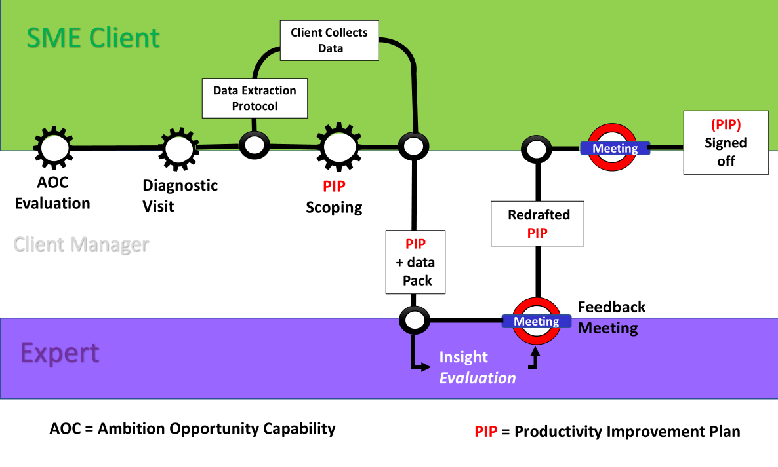


Programme Schematic
BPS

Slide 4
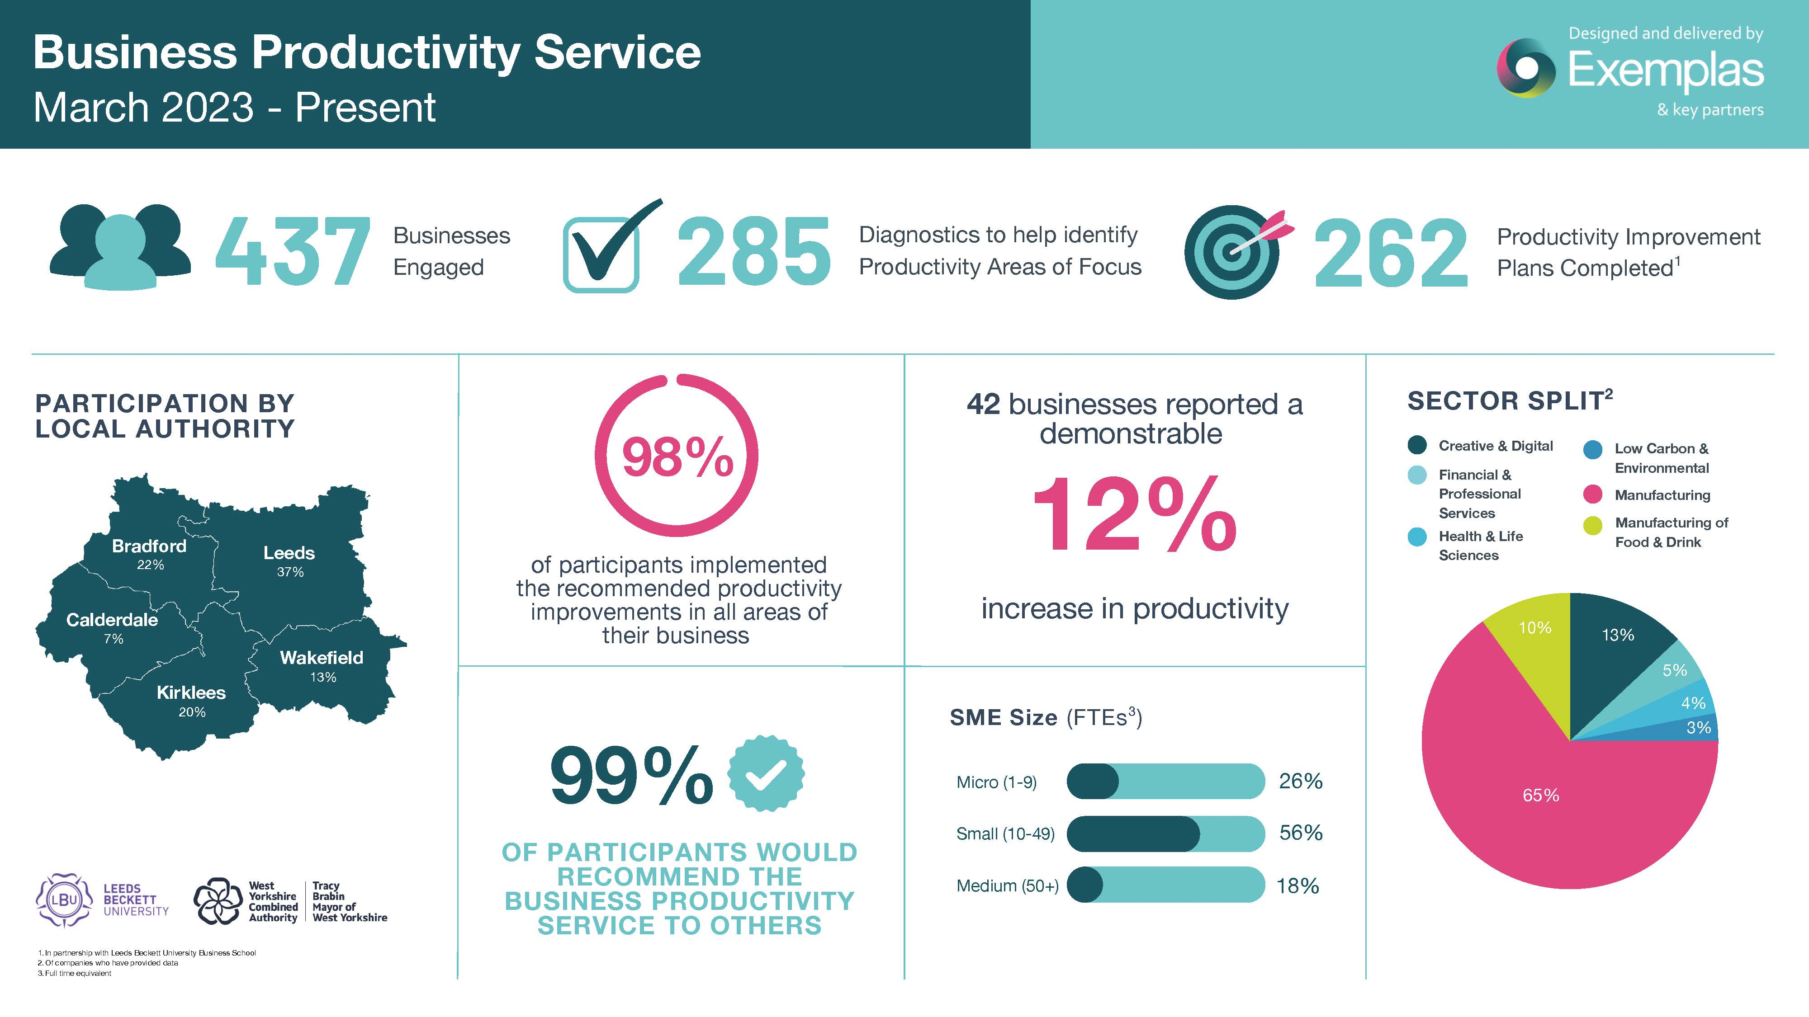
PROGRAMME IMPACT
Notes:
Martin

Slide 5
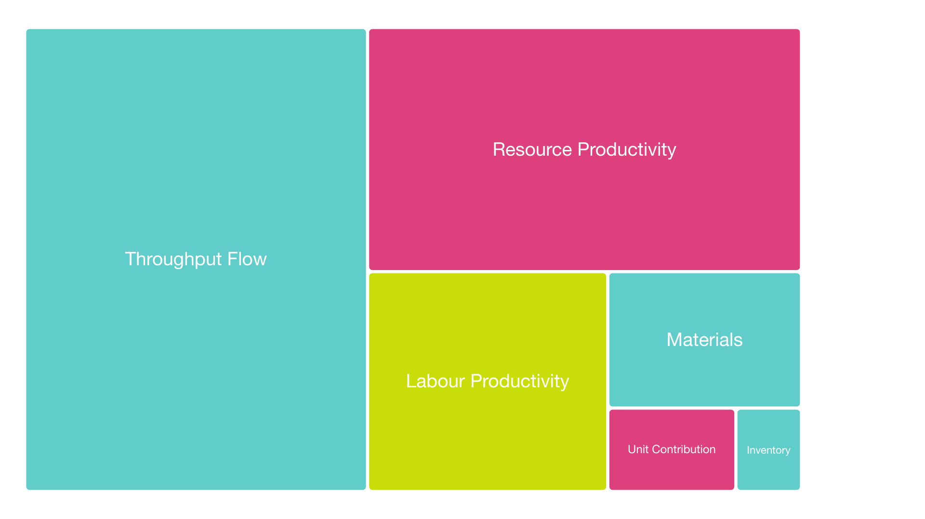
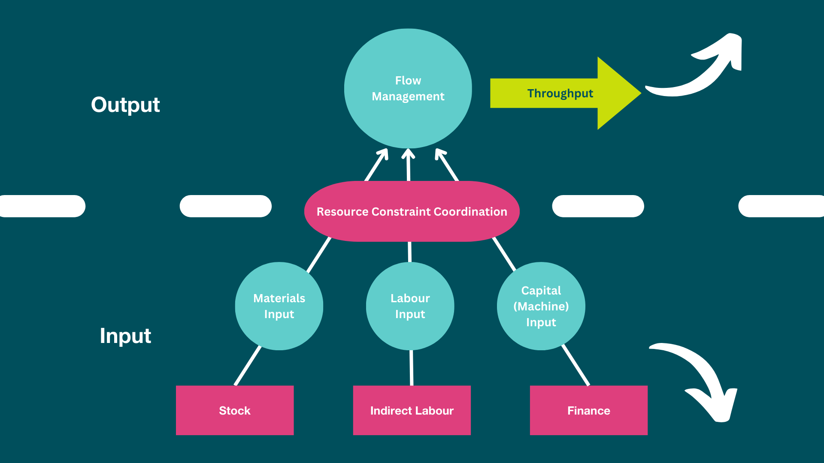
SME Productivity Focus
Complex
Capability
Most common areas of focus from #250+ businesses

Slide 6
Critical Factors
Depth of engagement
Confidence
Externality
Dialogue
Data Extraction
Diagnostic
SME
Action
Translation
Context
Design
Notes:
Ollie
Intro left hand side – summarise core research question Summary Paper – talk through the different hexagons – some key relationships

Slide 7




Want to find out more?
Dr Ollie Jones
Principal Lecturer
Listen to our podcast
https://beyond-busy-podcast.buzzsprout.com/
o.jones@leedsbeckett.ac.uk
Rob Sale
Head of Business Development, Exemplas
Read our insight papers
https://exemplas.com/tag/exemplas-lbu-insight-papers/
robs@exemplas.com

