Slide 1






Raising Concerns when on placement in Leeds

Slide 2
Contents
Process for raising concerns when on placement
The nominated person (PLF) contact details per organisation
Other key contacts per organisation
The importance of PARE
‘Who would you contact’ scenarios
Notes:
Have you contacted your Practice Assessor?
Do you know that any Practice supervisor can complete the initial interview with you?
It is a good idea to book in the mid-point and final interview when you have the initial so a repeat of this problem is avoided later on in the placement.
If your PA/PS is struggling to access Pebblepad, give them the email address for your HEI’s Pebblepad team.
If you struggle to sort this with a PA/PS, escalate to your Nominated Person.

Slide 3
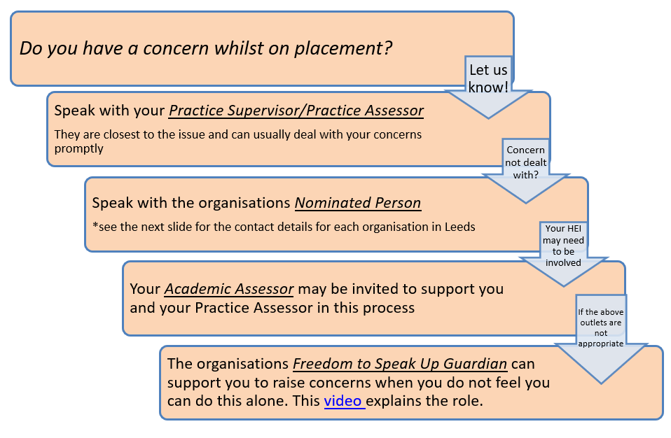
Process for Raising Concerns on placement
Notes:
Have you contacted your Practice Assessor?
Do you know that any Practice supervisor can complete the initial interview with you?
It is a good idea to book in the mid-point and final interview when you have the initial so a repeat of this problem is avoided later on in the placement.
If your PA/PS is struggling to access Pebblepad, give them the email address for your HEI’s Pebblepad team.
If you struggle to sort this with a PA/PS, escalate to your Nominated Person.

Slide 4


Organisation | ‘Nominated Person’ contact details
 | Practice Learning Facilitator Caroline Duggan Caroline.duggan@nhs.net
 | Practice Learning Facilitator Hayley Ingleson hayley.ingleson@nhs.net or learning.support@nhs.net
 | For undergraduate learners Practice Learning Facilitator team Leedsth-tr.practicelearningfacilitator@nhs.net For work-based learners Work Based Learners team leedsth-tr.workbasedlearners@nhs.net
 | Practice Learning and Development team pldt.lypft@nhs.net
 | Clinical Educator Zarah Rafique Zarah.raffique@nuffield.com
Our organisations have other outlets of support such as Race Equality groups, LGBTQ+ groups, Learning Disability networks and Equality and Diversity Leads. Details can be found on the following slides.

Slide 5
Key contacts in Leeds Community Healthcare Trust
Freedom to Speak up Guardian . John Walsh can be found on john.walsh@nhs.net 07949 102354
Race Equality Freedom to Speak up Champions. Working alongside our Freedom to Speak Up Guardian John Walsh. If you have an immediate concern, you can also speak to one of the REN Elected Members lcht.ren@nhs.net or HR 01132033455 lch.hr@nhs.net.
Rainbow Ambassadors and Disability Champions. Working alongside our freedom to speak up guardian John Walsh. If you feel you need to raise a concern or would like to speak to someone there are a number ambassadors and champions across LCH. Please contact John Walsh for further information 07949 102354 john.walsh@nhs.net
LCH Safeguarding team: lchsafeguardingteam@nhs.net
Notes:
Have you contacted your Practice Assessor?
Do you know that any Practice supervisor can complete the initial interview with you?
It is a good idea to book in the mid-point and final interview when you have the initial so a repeat of this problem is avoided later on in the placement.
If your PA/PS is struggling to access Pebblepad, give them the email address for your HEI’s Pebblepad team.
If you struggle to sort this with a PA/PS, escalate to your Nominated Person.

Slide 6
Key Contacts in Leeds Teaching Hospitals and Leeds Children’s Hospital
Freedom to Speak Up Guardian Alan Shephard leedsth-tr.speakup@nhs.net 07798698879
Learning Disabilities and Autism leedsth-tr.ldautism@nhs.net 0113 2066836
BME staff network leedsth-tr.bme@nhs.net
LGBT+ staff network ledsth-tr.lgbt@nhs.net
Children's safeguarding Leedsth-tr.SafeguardingChildren@nhs.net 0113 3923937
Adults safeguarding Leedsth-tr.safeguardingadults-ltht@nhs.net 0113 2066964
Notes:
Have you contacted your Practice Assessor?
Do you know that any Practice supervisor can complete the initial interview with you?
It is a good idea to book in the mid-point and final interview when you have the initial so a repeat of this problem is avoided later on in the placement.
If your PA/PS is struggling to access Pebblepad, give them the email address for your HEI’s Pebblepad team.
If you struggle to sort this with a PA/PS, escalate to your Nominated Person.

Slide 7
Key Contacts in Leeds and York Partnership Foundation Trust
Freedom to speak up Guardian John Verity - raisingconcerns.lypft@nhs.net 07980 959 407.
Rainbow Alliance (LGBT+) RainbowAlliance.lypft@nhs.net
Diversity and Inclusion caroline.bamford@nhs.net 07980 956712
WREN Workforce Race Equality Network https://youtu.be/ZLE3ghba0vI
WRES - Workforce Race Equality Standard: wres-staffnetwork.lypft@nhs.net
DaWN - Disability & Wellbeing Network: diversity.lypft@nhs.net
Safeguarding
Operate on a duty desk system safeguarding.lypft@nhs.net 0113 855 5971
Head of Safeguarding: janet.smith55@nhs.net, Deputy Head: lisa.borrick@nhs.net
Notes:
Have you contacted your Practice Assessor?
Do you know that any Practice supervisor can complete the initial interview with you?
It is a good idea to book in the mid-point and final interview when you have the initial so a repeat of this problem is avoided later on in the placement.
If your PA/PS is struggling to access Pebblepad, give them the email address for your HEI’s Pebblepad team.
If you struggle to sort this with a PA/PS, escalate to your Nominated Person.

Slide 8
Key Contacts in Leeds Beckett University
Key contacts can be found at: Reporting Injuries and Emergencies : Practice Placements (leeds.ac.uk)
Freedom to speak up guardian Claire Price: C.E.Price@leedsbeckett.ac.uk
For general enquiries: nursingplacements@leedsbeckett.ac.uk
Notes:
Have you contacted your Practice Assessor?
Do you know that any Practice supervisor can complete the initial interview with you?
It is a good idea to book in the mid-point and final interview when you have the initial so a repeat of this problem is avoided later on in the placement.
If your PA/PS is struggling to access Pebblepad, give them the email address for your HEI’s Pebblepad team.
If you struggle to sort this with a PA/PS, escalate to your Nominated Person.

Slide 9
Key Contacts in The University of Leeds
Key contacts can be found at: Reporting Injuries and Emergencies : Practice Placements (leeds.ac.uk)
Freedom to speak up guardians Robina Mir and Farhana Mulla : medfsug@leeds.ac.uk
For general enquiries : placements@healthcare.leeds.ac.uk
Notes:
Have you contacted your Practice Assessor?
Do you know that any Practice supervisor can complete the initial interview with you?
It is a good idea to book in the mid-point and final interview when you have the initial so a repeat of this problem is avoided later on in the placement.
If your PA/PS is struggling to access Pebblepad, give them the email address for your HEI’s Pebblepad team.
If you struggle to sort this with a PA/PS, escalate to your Nominated Person.

Slide 10

What is PARE?
PARE or Practice Assessment Record and Evaluation is the definitive healthcare practice placement quality assurance and monitoring tool used to enable integration and development across healthcare practice learning.
Notes:
Have you contacted your Practice Assessor?
Do you know that any Practice supervisor can complete the initial interview with you?
It is a good idea to book in the mid-point and final interview when you have the initial so a repeat of this problem is avoided later on in the placement.
If your PA/PS is struggling to access Pebblepad, give them the email address for your HEI’s Pebblepad team.
If you struggle to sort this with a PA/PS, escalate to your Nominated Person.

Slide 11
Why is PARE important?
How it helps you | How it helps us
The placement profile gives a detailed overview to allow you to prepare for placement. Access this to find contact details for the area and be pro-active in reaching out to them | Our placements are audited on PARE and data is shared with HEE to ensure our learning environments are quality assured
It gives you a voice through the evaluation process, allowing you to be instrumental in service improvement | Your evaluation helps us to celebrate the positives of the learning environment and identify what can be improved
Notes:
Have you contacted your Practice Assessor?
Do you know that any Practice supervisor can complete the initial interview with you?
It is a good idea to book in the mid-point and final interview when you have the initial so a repeat of this problem is avoided later on in the placement.
If your PA/PS is struggling to access Pebblepad, give them the email address for your HEI’s Pebblepad team.
If you struggle to sort this with a PA/PS, escalate to your Nominated Person.

Slide 12
Placement Evaluation on PARE
PARE evaluations are really helpful in identifying areas in which our placements excel so we can provide all-important positive feedback to teams that work hard to ensure your learning experiences are effective. They are also helpful to assist in identifying areas for improvement.
A few points to note to get the most from the evaluation process:
Your name is NOT anonymous. Your PLF, Education Leads for the placement, and your university can see who has written evaluations so they can support you if there are issues raised and provide feedback to staff to celebrate what's going well
The evaluation is not the place to escalate concerns. Please raise any practice issues in a timely manner during your placement so we can look to improve your experience while it is still happening
Please keep your feedback confidential - DO NOT name members of staff or service users
Leaving free text comments helps us to understand the reasons behind your ratings and learn from them
If the positivity rating of the placement comes out below the average for that placement area, please expect to be contacted for a meeting so we can listen and learn from your experience
Remember to remain professional. Please consider the timing of completing your evaluation, do not complete in anger! You are held accountable for what you write
Complete the evaluation as close to the end of placement as you can so it is an accurate reflection of your experience
Notes:
Have you contacted your Practice Assessor?
Do you know that any Practice supervisor can complete the initial interview with you?
It is a good idea to book in the mid-point and final interview when you have the initial so a repeat of this problem is avoided later on in the placement.
If your PA/PS is struggling to access Pebblepad, give them the email address for your HEI’s Pebblepad team.
If you struggle to sort this with a PA/PS, escalate to your Nominated Person.

Slide 13
Who should you contact?
You are three weeks into a ten weeks placement but have had no initial interview nor any information completed within Pebblepad.
Answer:
Have you contacted your Practice Assessor and spoken to your University practice support tutor?
Do you know that any Practice supervisor can complete the initial interview with you?
It is a good idea to book in the mid-point and final interview when you have the initial so a repeat of this problem is avoided later on in the placement.
If your PA/PS is struggling to access Pebble pad, give them the email address for your HEI’s Pebble pad team.
If you struggle to sort this with a PA/PS, escalate to your Nominated Person (which is the trust PLF in Leeds)
Notes:
Have you contacted your Practice Assessor?
Do you know that any Practice supervisor can complete the initial interview with you?
It is a good idea to book in the mid-point and final interview when you have the initial so a repeat of this problem is avoided later on in the placement.
If your PA/PS is struggling to access Pebblepad, give them the email address for your HEI’s Pebblepad team.
If you struggle to sort this with a PA/PS, escalate to your Nominated Person.

Slide 14
Who should you contact?
Your Practice Assessor completed your mid-point interview but has gone off sick and will not be returning before the end of your placement. No other staff in the area seem to know what to do.
Answer:
Escalate to your Nominated Person who can assist in allocating you a new Practice Assessor.
The reasons for this must be documented in Pebblepad.
You must notify your University practice support tutor before your placement ends
Notes:
Escalate to your Nominated Person who can assist in allocating you a new Practice Assessor.
The reasons for this must be documented in Pebblepad.

Slide 15
Who should you contact?
You witness practice that you feel is inappropriate by the Practice Supervisor you are working with that day.
Answer:
Are you able to have a conversation with the PS to discuss their practice? There may be a lack of understanding that can be turned into a learning opportunity.
Can you discuss this with your PA / the manager of the clinical area?
Should you be raising a concern with your University practice support tutor?
Do you need to contact your nominated person?
Do you need support to ‘speak up’ through the Freedom to Speak Up Guardian in your placement area or back at your University?
Notes:
Are you able to have a conversation with the PS to discuss their practice? There may be a lack of understanding that can be turned into a learning opportunity.
Can you discuss this with your PA, the manager of the clinical area?
Do you need to contact your nominated person?
Do you need support to ‘speak up’ through the Freedom to Speak Up Guardian?

Slide 16
Who should you contact?
You are ill and cannot attend placement.
Answer:
You must follow your HEI policy to report your sickness an the first day of absence in addition to making a telephone call to the practice area, making a note of who you spoke to and at what time.
An email is not appropriate as clinical staff may not have access to this for some time.
You must then arrange when you will next contact them to keep them informed of your plans for returning/staying away from placement.
All absences must be recorded in Pebblepad and hours adjusted accordingly.
Notes:
You must follow your HEI policy to report your absence in addition to making a telephone call to the clinical area.
An email is not appropriate as clinical staff may not access this for some time.
You must then arrange when you will next contact them to keep them informed of your plans for returning/staying away from placement.
Absences must be recorded in Pebblepad.

