Slide 1

Student Services
Disability Advice, Support Worker Service
Support Worker Resources
Finding Key Contact Information

Slide 2
Introduction
In this guide you will be shown who the key people your course are.
We will look at when and why you may need to contact them.
You will be shown where you can find contact information.
On each page there will be an option to listen to audio or watch a How-To video.

Slide 3
Key Course Contacts
Course Admin
For course related problems or questions, and general university related information.

Slide 4
Key Course Contacts
Academic Advisor
Assigned to you at induction and act as your personal tutor.

Slide 5
Key Course Contacts
Course Leader
  Speak to them about course related comments or questions.

Slide 6
Key Course Contacts
Module Leader
  Speak to them about module related questions or comments.

Slide 7
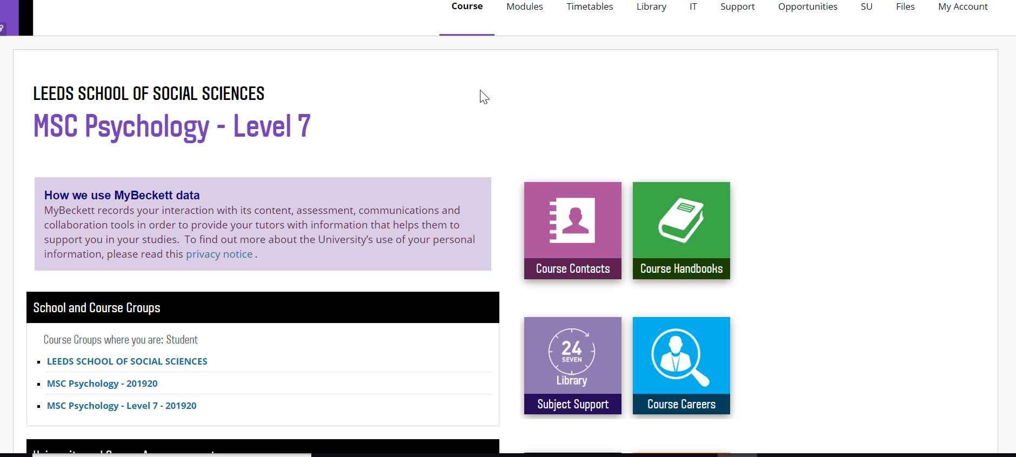
Where are the contact details: MyBeckett
MyBeckett homepage > Course Contacts > Course Admin and Course Director contact details.
Modules > Select relevant module > Module Leader contact details

Slide 8

Where are the contact details: Module Handbooks
MyBeckett > Modules > select the relevant module > Module Handbook > Communications > Module specific and general Course contact details.

Slide 9

Where are the contact details: Course Handbook
MyBeckett > Course Handbooks > A-Z (select you course and level) > Key Contacts > All key course contacts.

Slide 10
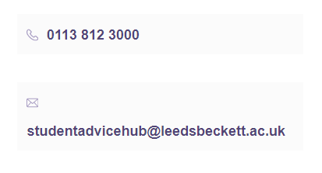
Tips
If you are unsure contact:
Your Course Admin
Student Advice Hub Team:

Slide 11
Contact Details:
supportworkerservice@leedsbeckett.ac.uk
disabilityadvice@leedsbeckett.ac.uk

