Slide 1
Spectrum : How to Find Us
ROOM G02 Calverley Building, City Campus

Slide 2
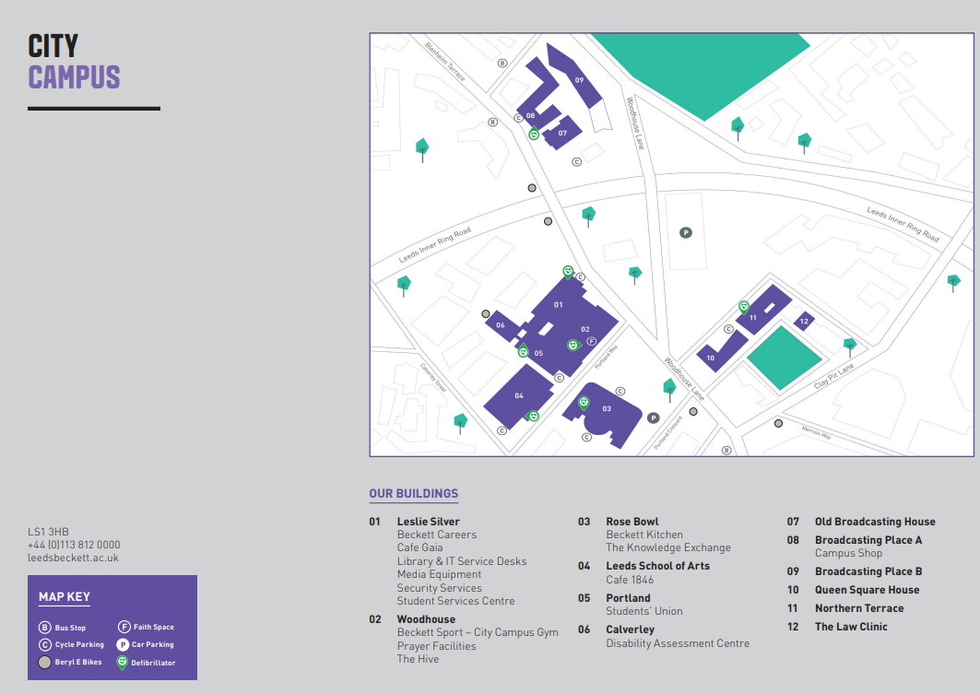
How to find us
Locate Building 01 – Leslie Silver Building
See Image on next page.
Please follow the link for a PDF
mu_campus_maps.pdf

Slide 3
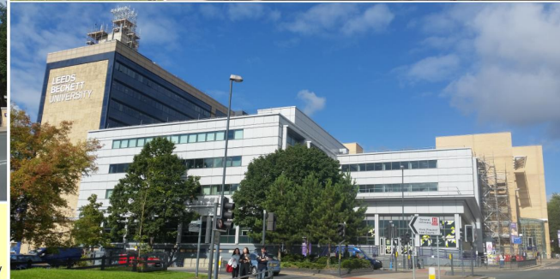
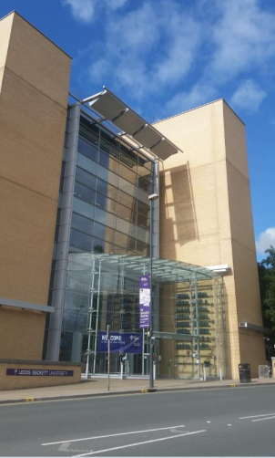
We suggest using the main doors to the Leslie Silver Building to get into the Calverley Building. The buildings are connected ( the above picture shows the
Building we are located in ) and the arrow points to the main doors.
On the Picture on the right, you will see the main doors to the Leslie Silver Building that you will need to go through.

Slide 4
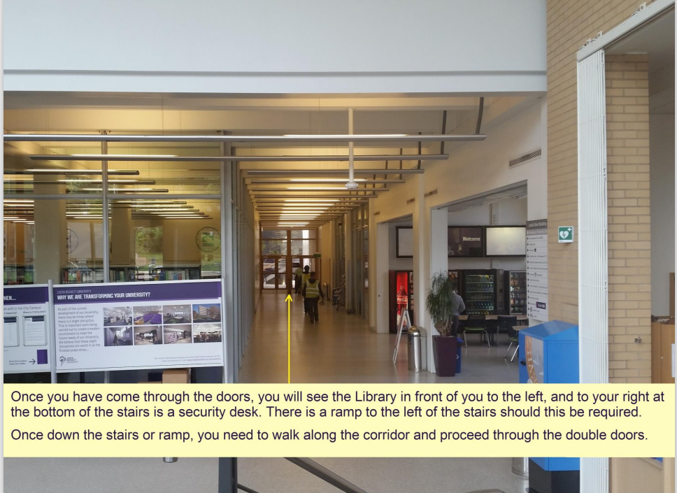

Slide 5
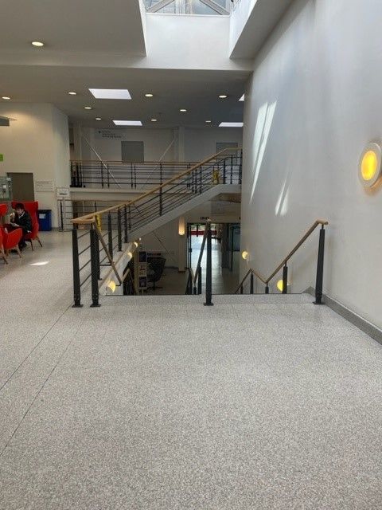
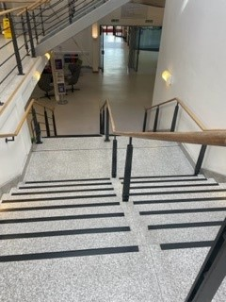
Once through the double doors you will reach the café on the left-hand side and steps directly in front of you.
You will need to walk down the stairs to the LG floor.
Lift access is behind the café ( see yellow circle )

Slide 6
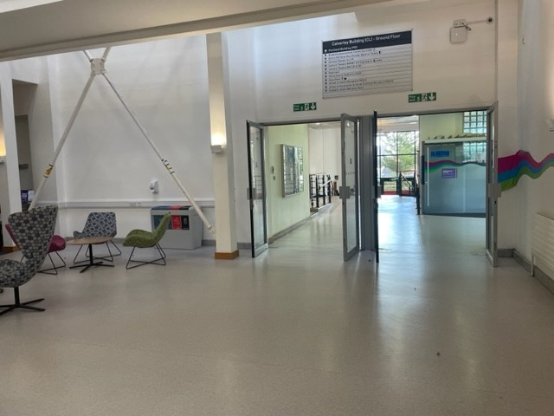
Once down the stairs you will pass a seating area on the left and will need to continue through the next set of doors, head forward until you reach a set of stairs.

Slide 7
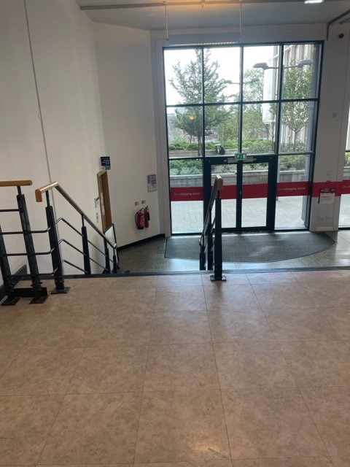
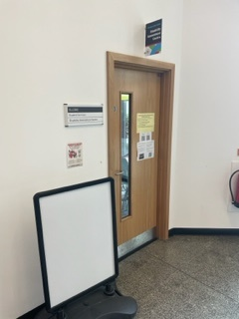
Head down the stairs and the room for Spectrum is on the left

Slide 8
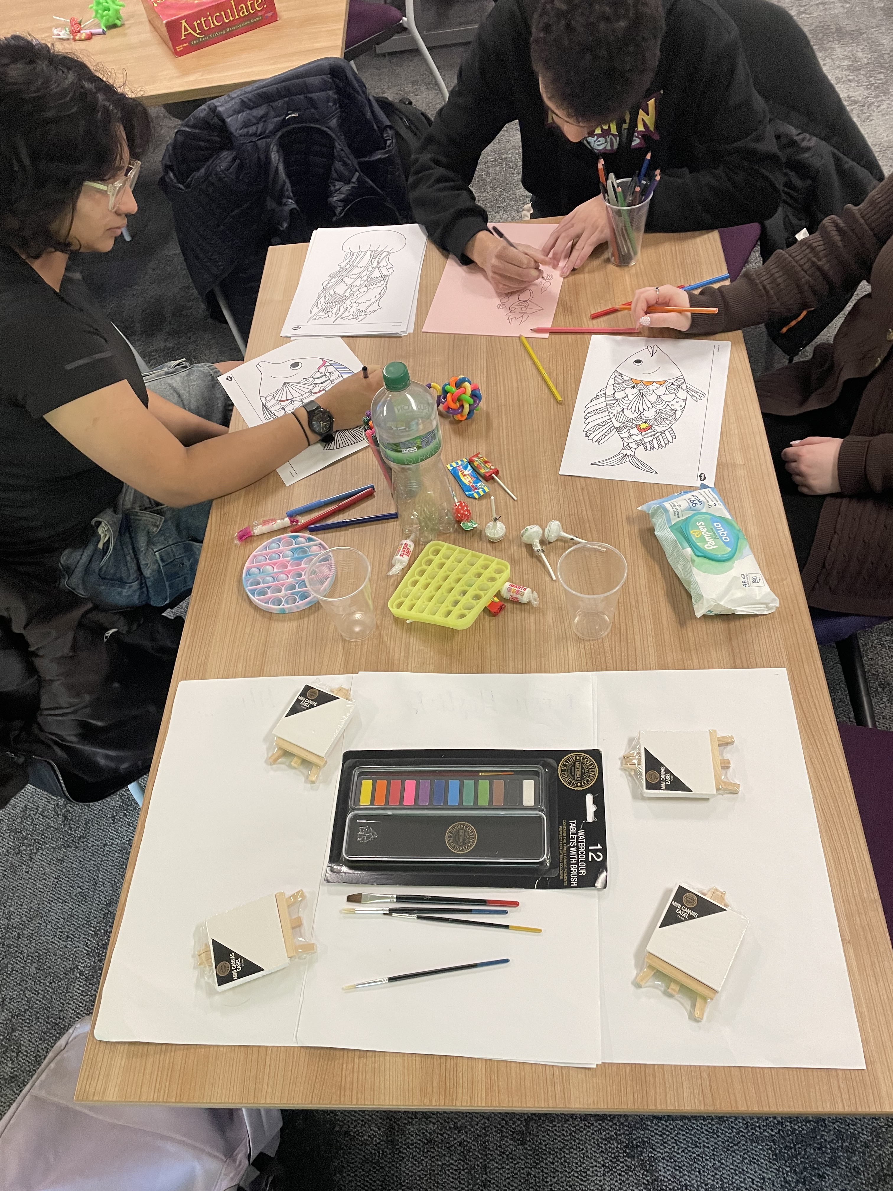
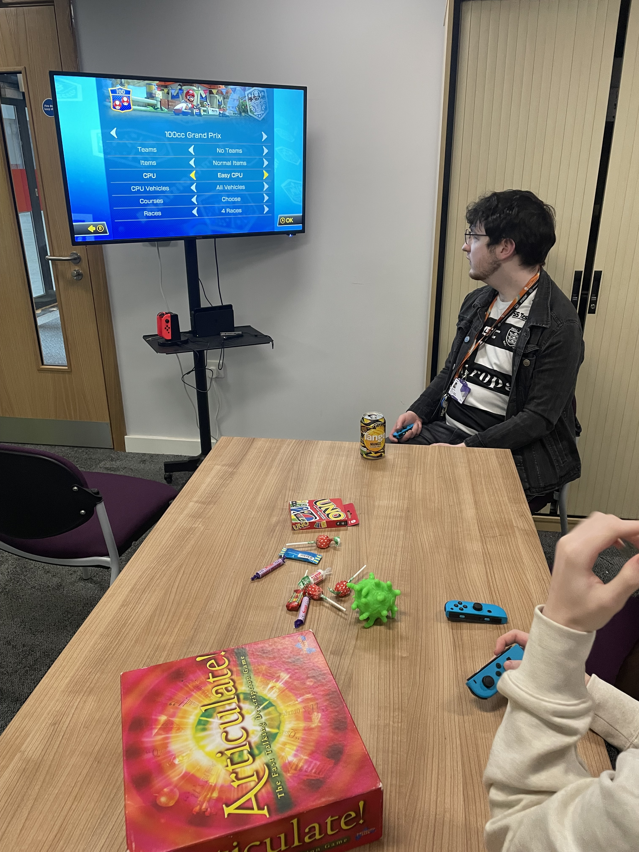
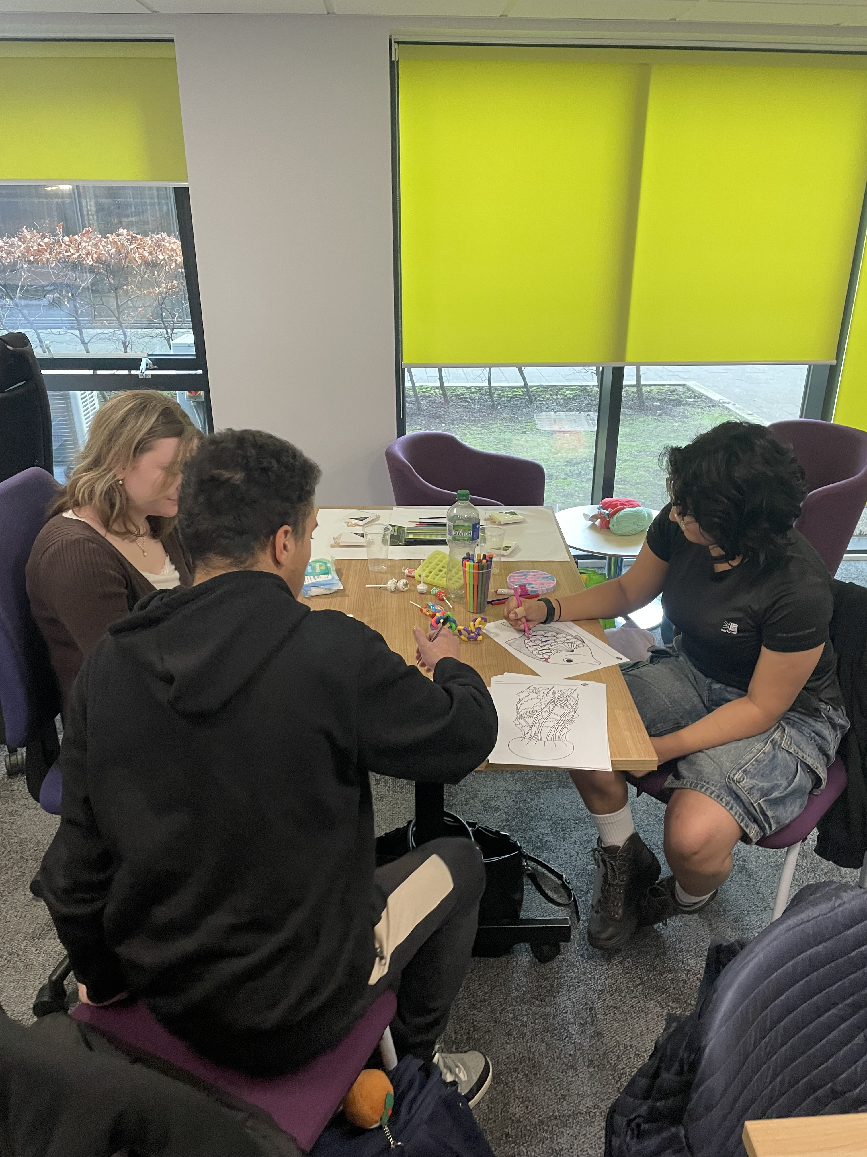
Activities
There are a range of activities available such as arts and crafts, board games, computer games and we often arrange guest speakers or workshops based on topics of interest. We will advertise these in advance through our email newsletter and webpages. Attendance is flexible, so you can come to every group meeting or only occasionally. You don't need to book, just turn up. You can email Lisa and Kate who help to facilitate the group by using this link

Slide 9
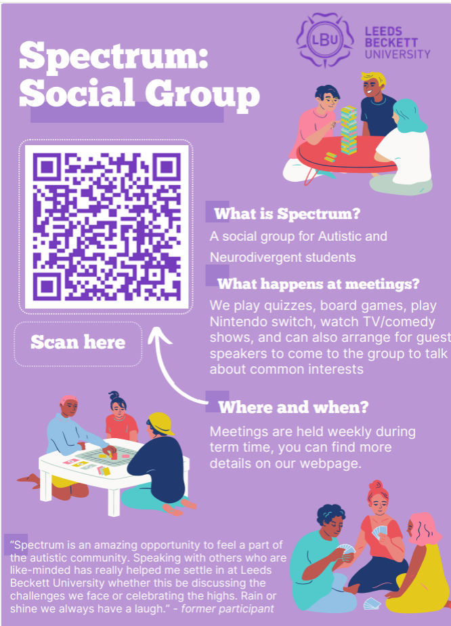
Any questions?
If you would like to be added to our mailing list, if you have any questions or if there is anything else we can help with please email us at spectrum@leedsbeckett.ac.uk

