Slide 1

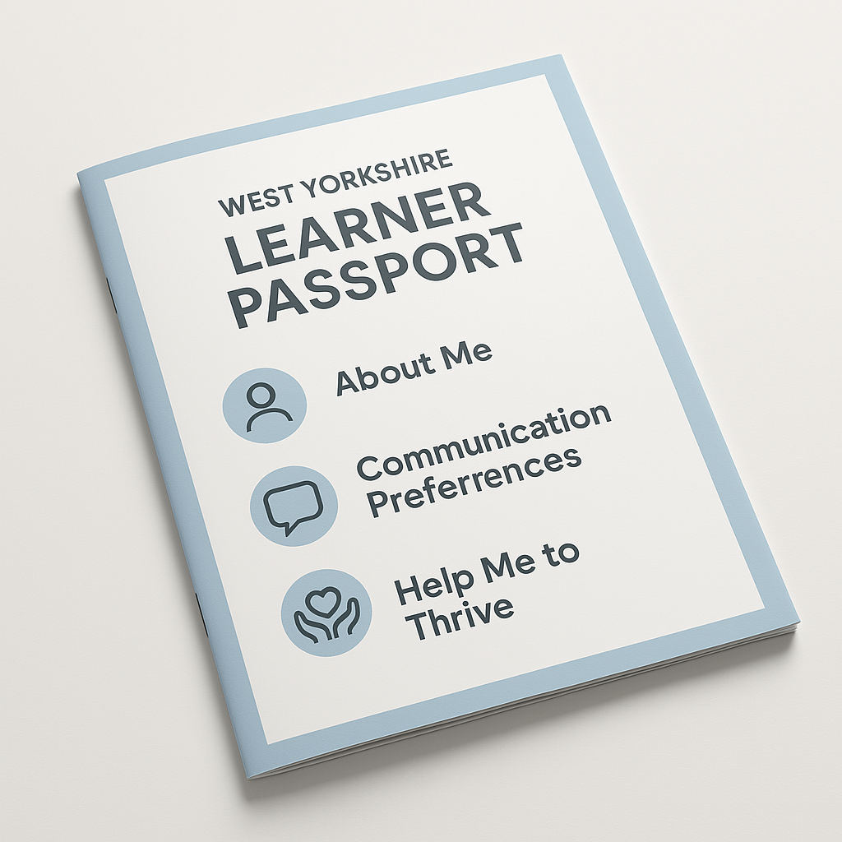
West Yorkshire Learner Passport
Guidance for Staff Supporting Students on Placement
Notes:
Welcome everyone and thank you for taking the time to review this recorded presentation on the WY Learner passport.
For those who may not be aware, the Learner Passport was developed over the summer period in collaboration with Education providers, Learners and Staff supporting students, in response to a system-wide request to create a resource that supports early conversations between learners and educators. The aim is to help placement areas know more about a student before they arrive, ensuring a smoother, more supportive experience for everyone involved. It was launched on the 29th September, and whilst we don’t expect all students to be using it by now, what we do expect is a gradual uptake as the process becomes more familiar and embedded within the system.
If you’ve already read the User Guide, much of the information we’ll discuss today will be a recap or summary of what’s included there.
Please note that formal feedback will be collected in the early new year. The Passport has been developed by us listening to the needs of the system, and taking into consideration all the points we have heard to date. While we really value your thoughts and reflections, we’re not in a position to make changes at this stage. However, we’ll be reaching out to colleagues early next year with further information about how we’ll be evaluating the Learner Passport to ensure it’s fit for purpose and continues to meet the needs of both learners and educators.

Slide 2
Purpose of this session
Provide an overview of what the passport is – and what it is not
Outline the content of the passport and where to access it
Clarify responsibilities:
Learners
Education providers
Staff supporting learners on placement.
Walk through the full process from start to finish
Next steps
Share additional resources and support available.
Notes:
The purpose of today’s session is to:
Provide an overview of what the Learner Passport is designed to do — and equally, what it isn’t.
Outline the content of the passport and explain how you can access both the template and the accompanying user guide.
Clarify the responsibilities of everyone involved, so it’s clear what your role — and the roles of others — are within the process.
Walk through a step-by-step guide of the process from start to finish.
All of this information is also detailed in the User Guide, but today we’ll take the opportunity to talk it through together.
Finally, we’ll discuss next steps and highlight additional resources available to support the implementation of the Learner Passport.

Slide 3

What is the Learner Passport
It is a learner-owned document.
Designed so learners can introduce themselves and highlight any health or wellbeing considerations prior to the placement start date.
It can also guide initial placement meetings and mid point reviews.
Not mandatory and cannot be enforced.
Learners will decide what they feel comfortable to share.
For every learner
Developed by the system, to benefit the system.
Notes:
The Learner Passport is a learner-owned document — this means that the learner has full control over what they choose to include and share.
It is designed to allow learners to introduce themselves before a placement begins, helping educators understand more about them in advance. This may include sharing information such as learning preferences, areas of interest, or any health or wellbeing considerations they wish to highlight before the placement start date.
The passport can be a helpful tool to support:
Initial placement meetings
Induction conversations, and
Mid-point reviews
It’s important to note that the passport is not mandatory. While we strongly encourage learners to complete it, participation is their choice, and they decide what information to share.
You may notice that some sections are left blank — this could be because the learner doesn’t feel comfortable sharing certain details, or simply because there’s nothing relevant to include. This may require some further discussion when they start placement.
The Learner Passport is designed for every learner on a health and care course requiring a placement across West Yorkshire — spanning all health and care courses, training providers, and education levels, including undergraduate, postgraduate, and T-Level learners.

Slide 4

What the Learner passport is not
This is an information document not a request document.
It doesn’t guarantee a placement can be adapted for all preferences.
It is not designed to replace any existing university or college placement reasonable adjustment plans. Please follow existing education provider processes for these documents.
Notes:
It’s equally important to understand what the Learner Passport is not.
The Learner Passport is an information document, not a request document.
It is designed purely to share information and to support early conversations — it does not guarantee that a placement can be adapted to meet every preference or need listed.
Students are made aware of this distinction. Likewise, educators should not assume that because something is mentioned within the passport, the learner is requesting an adjustment. Instead, the information is there to open up meaningful discussions about how best to support the learner within the placement environment.
The Learner Passport is not intended to replace any existing university or college reasonable adjustment plans. Those formal processes remain unchanged. What the passport can do, however, is prompt learners to share their existing adjustment plans with placement areas, helping ensure that everyone is informed and aligned from the outset.

Slide 5
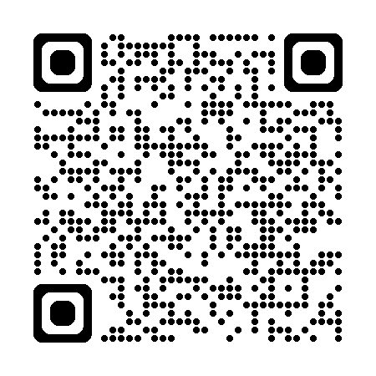
Learner Passport Content
1. About me
Name, Pronouns, Course, Year of training, education providers.
Any previous experience in health or care
Any personal commitments, circumstances of appointments
Travel
2. Learning preferences
3. My health and support needs
Placement reasonable adjustment plans
Health, wellbeing or welfare considerations
Sensitive topics
4. Any additional information learners would like to share
5. Date passport was last updated
Link to passport template and guide
Notes:
We hope you will have seen the passport template by now but If not, you can scan the QR code shown here, which will take you directly to the page where you can access both the template and the user guide.
The content of the passport was developed following extensive consultation and our goal was to identify what information would be most valuable for both learners and educators. There was a lot we could have included, but we made a conscious decision to keep the document to a maximum of two sides of A4 — to make it concise, impactful, and easy to complete and read.
The sections we’ve included reflect the most common and important themes raised during consultation.
1. About Me
This section gives learners an opportunity to introduce themselves by sharing:
Their name, pronouns, course, year of training, and education provider
Any previous experience in health or care — including placements, paid work, volunteering, or lived experience
Any personal information they wish to disclose, such as personal commitments, appointments during placement, childcare, or religious events
Travel circumstances, for example: “I live in Huddersfield and will be using public transport as I’m not a car driver.”
This section encourages learners to think ahead about travel and logistics, while helping educators understand any factors that might influence attendance or timetables. All fields are free-text boxes, allowing learners to express themselves in their own words — rather than through tick boxes or closed questions.
2. Learning Preferences
This section allows learners to describe how they learn best and to share any strategies that have helped them succeed previously. Educators told us this would be particularly useful in helping them tailor their approach and support individual learning styles more effectively.
3. My Health and Support Needs
Here, learners can note any placement reasonable adjustment plans (RAPs) they have in place. They can also share additional health, wellbeing, or welfare considerations that may not be covered in a RAP — for example, if they have recently experienced a bereavement or other personal circumstance that may affect them during placement, or an allergy they wish to mention. This section is intended to promote understanding and proactive support, not to replace existing processes.
4. Additional Information
This final free-text section allows learners to share anything else they feel is relevant to their placement — giving them space to include details not covered elsewhere.
5. Date Last Updated
The last section records when the passport was most recently updated. While we wouldn’t expect learners to revise it continuously, it should be reviewed and updated after each placement to ensure the information remains current and accurate.

Slide 6

Students Responsibilities
Complete the passport
Fill in before the placement starts, use the document throughout your training and update details when circumstances change. Continue to communicate any changes with your educators. Seeking support from personal tutor if needed.
Sharing your passport
Aim to share with staff supporting the placement at least 2 weeks before. This can be sent via email. Staff reviewing the passport may follow up with you if there is anything that would benefit further discussion.
You decide what you feel comfortable sharing.
Information provided will be used to support students, never to disadvantage them
Notes:
Responsibilities – Who Does What:
Now we’re going to move on to the responsibilities of everyone involved in the Learner Passport process. The aim here is to make it clear and transparent what each person’s role is, and how the process should work in practice.
Learner Responsibilities:
Learners are responsible for completing their own Learner Passport.
They should:
Complete it before their placement begins, and Update it whenever their circumstances change.
The same passport can be used throughout their training journey, being updated and refined as needed.
It’s really important to note that the Learner Passport does not replace verbal communication. If something changes during placement, learners should speak directly with the staff supporting them. They can also seek help from their personal tutor or education provider if they need support in completing the passport.
Sharing the Passport
It is the learner’s responsibility to share their passport. They should aim to send it to their placement area around two weeks before the placement starts.
However, we recognise that in some cases, learners may not receive their placement allocation that far in advance. If that happens, they should share the passport as soon as possible, and it’s important that they are not judged or penalised for any delay.
Some learners may also choose not to complete the passport or may have very little information to share — and that’s absolutely fine. As educators, you can signpost them to the passport and encourage completion, but ultimately it is their choice.
Using the Information
Learners decide what they feel comfortable sharing, and any information they do provide should be used to support and enable them — never to disadvantage them.

Slide 7

Education Provider responsibilities
Introduce the passport to learners and provide details on how they can access the template and guidance.
Encourage that students complete the passport as part of preparation for placement.
Support learners – offer help with completing the passport if required, including signposting to personal tutors or other support available.
If learners disclose welfare, wellbeing or other aspects on their passport, be aware that this may require an education provider discussion and/or response.
Notes:
Education Provider Responsibilities:
Our Education Providers — including universities, colleges, and training organisations — play a key role in supporting the successful use of the Learner Passport.
Introducing the Passport
Education providers are responsible for introducing the Learner Passport to their students and explaining how to access the template and user guide.
Encouraging Completion:
Providers should encourage learners to complete the passport as part of their preparation for placement. This helps to normalise the process and ensures that students see the value in using it as a reflective and preparatory tool.
Offering Support:
Education providers should be ready to offer support to learners who may need help completing their passport.
This might involve:
Direct support from personal tutors, or
Signposting to other relevant student support services.
The aim is to make sure that all learners — regardless of their confidence or experience — can complete the passport effectively and feel supported in doing so.
Responding to Disclosures
Lastly, it’s important that education providers are aware that learners may include welfare, wellbeing, or personal information within their passport. In some cases, these disclosures may require follow-up conversations or additional input from the training provider.

Slide 8

Staff supporting Learner's responsibilities
On first contact, check if the learner has a passport and encourage them to share it with you, if they haven’t already. Learners should aim to send this 2 weeks before their placement start date. Who this is sent to within your organisation may differ.
Review the passport: Take time to read and consider how it may inform planning, preparation or support.
Support initial conversations: Use the passport to guide initial placement meetings, helping to personalise the learner’s placement experience. It can be helpful to refer to again during longer placements such as T-Level placements.
Check for reasonable adjustments: Learners with a Placement Reasonable Adjustment Plan are encouraged to share this with you.
Notes:
Staff Supporting Learners – Responsibilities
We’ve chosen to use the term “staff supporting learners” as a generic phrase that encompasses everyone involved in supervising or supporting students on placement. We recognise that different organisations use different titles — such as educator, assessor, mentor, practice supervisor, or placement coordinator — but for the purpose of this process, we’ll use one collective term.
Key Responsibilities:
1. Initial Contact When the learner makes contact — or when you reach out to them — please check whether they have a Learner Passport and encourage them to share it.
Each organisation may have its own approach to managing this. For example, some may ask learners to send their passport directly to the educator, while others may prefer it to go to a central education team. It’s up to individual organisations to decide what works best locally, but it’s important that students are clearly informed about the process in that area.
2. Reviewing the Passport When you receive a Learner Passport, take the time to read it carefully and consider how the information might inform your planning, preparation, or support for that learner. Even small details can help you understand their needs and preferences better and set the tone for a supportive placement experience.
3. Using the Passport in Conversations Use the passport to support initial meetings or induction discussions, where appropriate.It can also be useful to revisit the passport during the placement, for example at mid-point reviews, to reflect on progress or check if any circumstances have changed.
4. Considering Reasonable Adjustments Finally, please check for any information about reasonable adjustments. Learners may use the passport to highlight existing Reasonable Adjustment Plans (RAPs) or share other considerations. If this happens, ensure these are acknowledged and followed up appropriately, in line with your organisation’s existing policies and processes.

Slide 9

Staff supporting Learner's responsibilities
Respect confidentiality: Learners are asked in the passport whether they consent to sharing it with wider team members:
always respect their wishes
balance confidentiality with the need to ensure safety
discuss with the learner if clarification is needed
The passport is intended for informational purposes. If concerns arise that may require further support or attention, be sure to discuss them with the learner and confirm that the education provider is informed.
Notes:
Confidentiality and Information Sharing
It’s really important that we respect confidentiality when handling information shared through the Learner Passport.
Learners are explicitly asked whether they are comfortable with their passport being shared within the wider team. Some may agree to this, while others may prefer that the information is kept between themselves and their direct educator or supervisor. Please ensure that these wishes are respected.
That said, confidentiality should always be balanced with safety. If a situation arises where safety or patient care could be compromised, it may be necessary to share relevant information with others — but this should be done sensitively and appropriately. There is no need to share unnecessary detail or explain why a learner may not be able to do something; simply ensure that the situation is managed safely and respectfully.
If there is any uncertainty, please discuss it directly with the learner to clarify what they are comfortable sharing, and agree together how best to handle the information.
Responding to Concerns
Remember, the purpose of the Learner Passport is to share information, not to raise concerns — but occasionally, something disclosed in the passport or during discussion may indicate that a learner needs additional support.
If this happens:
Have an open conversation with the learner first, to understand their perspective and what support they might need.
If further support or input is required, inform the education provider, and
Wherever appropriate, include the learner in those discussions, ensuring transparency and collaboration throughout.

Slide 10

The process from start to finish
Education Provider introduces learner passport to Learner with guidance.
Learner completes their learner passport (with or without support from Education provider)
Education provider allocates placement and informs Learner of the allocation.
The Education provider will signpost and support the Learner to send the passport to the relevant contact at the placement. In most cases, the Learner will contact the placement provider and introduce themselves and ask for the passport to be shared.
Staff supporting learner receives the passport
Notes:
To support the implementation and use of the Learner Passport, we’ve created a step-by-step guide that outlines the process from start to finish.
The guide also highlights the people involved at each stage, so you can clearly see where your role fits within the process.
One key thing to note is that this is a learner-owned document. You’ll see this reflected in the guide by how frequently the “Learner” is highlighted — showing that responsibility for completion and sharing primarily sits with the student.
So the process is as followed:

Slide 11
The process from start to finish
Staff supporting placement reviews the passport and considers any adjustments, asking for appropriate support if required.
Learner stars placement, where passport is acknowledged and discussed to support learning.
During placement – Learner communicates any changes in circumstances.
End of placement – Learner reviews and updates their passport, identifying strategies they have found useful in preparation for their next placement.

Slide 12

Next Steps
Continue to raise awareness of the West Yorkshire Learner Passport
Review progress early next year, receiving feedback from educators, learners and education providers.
Recorded PowerPoint available to support implementation.
Video highlighting purpose and benefits of the Learner passport from Fatima Khan-Shah, West Yorkshire Inclusivity Champion. Made available in same location.
Notes:
In terms of next steps – we want to keep you informed of what will happen next.
The passport was launched on the 29th September, what we are continuing to do and ask you to do is raise awareness of the passport. By raising awareness, it will improve uptake and ultimately benefit you in your role and learners on placement.
We are going to review progress early next year, listening to educators, learners and education providers to gain feedback and understand if any changes or updates are necessary.
Lastly, we are going to share a video on the same page, from Fatima Khan – Shah, WY inclusivity champion. Which highlights the purpose and benefits of the learner passport.

Slide 13
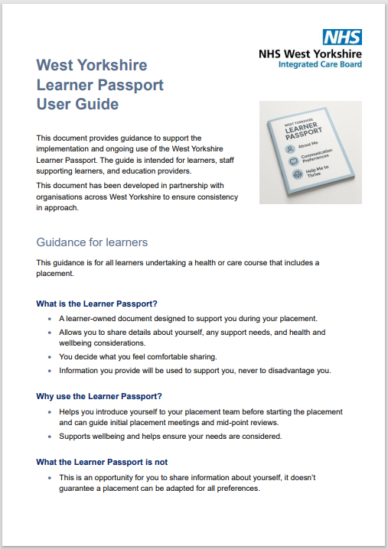
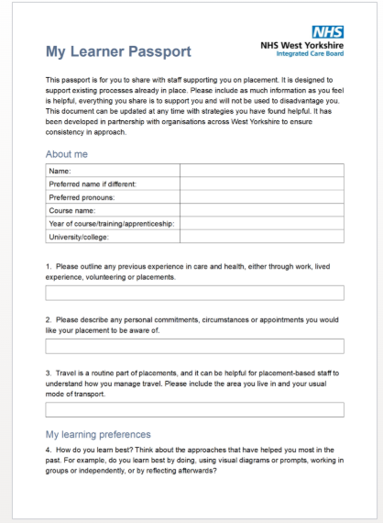
Resources to support you
Video – Link to follow
Recorded Presentation – Link to follow
West Yorkshire ICB Placement Strategy :: West Yorkshire Health & Care Partnership
Notes:
Lastly, resources.
We wanted to share these with you and many we have already discussed.
Firstly, if you scan the QR code or click the link – this takes you to the landing page we discussed – which currently has the template and guide ready to download. This is also where the Video and Presentation will sit, with links to follow once they are available.
Thankyou for listening and I hope you found this session useful. Please do share with colleagues who may also find this helpful.

