Slide 1

Practice Educator Conference 4th March 2026 Developing Skills in Nurse Leadership – the challenge of authentic assessment Senior Lecturers Gill Kelly & Louise Parker

Slide 2
Background
Post registration module - Leading and Managing with Compassion, forms an element of Specialist Practice but is relevant in terms of the wider context of nurse leadership at all levels of experience, training and education.
Develop our nurse leaders of the future ensuing that compassionate leadership is supported by experiential learning, in turn supported by self reflection, observation, role modelling and authentic assessment

Slide 3

Context of Compassionate Leadership
2012:Compassion in Practice, the national strategy for nurses, midwives and care staff
2014: Building and Strengthening leadership. Leading with Compassion (NHS England)
2020: The Courage of Compassion (Kings Fund)
3 core needs that must be met to ensure wellbeing and motivation at work, and to minimise workplace stress: autonomy, belonging and contribution.
8 Key recommendations including culture and leadership; and learning, education and development.
So that leads us to question, what does compassion in practice look like, how do we lead compassionately and how do we/you assess it authentically?

Slide 4
What do you think of when you consider compassion?

Slide 5

https://youtu.be/bUOUp0HsZCc

Slide 6
Compassion as a dimension of leadership
Compassionate Leaders have increased their awareness about their own strengths and weaknesses, needs and desires, qualities and shadow sides, fortes and blind spots, conscious and unconscious patterns.
In other words, they have entered on the journey of personal development.
Although this might sometimes feel like a scary enterprise in unknown waters, they have experienced that it makes them stronger
Vermeiren (2019) The Compassionate Leader

Slide 7
Question for group “chat”
Where/how in your current role are you expected to
Teach/demonstrate leadership
Assess leadership
Which students does this involve

Slide 8
Why compassionate leadership
compassionate leadership is everyone’s business …… to create a climate of compassion for both staff and patients, drawing on the indisputable links that exist between the experience of patients and the experience of staff
It is organic and is contextual to the environment.
It is therefore necessary to recognise and respond to uniqueness, independence and autonomy

Slide 9
Compassionate Leadership in the context of nursing practice and the learning environment
4 dimensions:
Self: awareness, resilience, mindfulness and emotional intelligence that allows you to be present and available to the needs of others.
Leader: the ability to notice the explicit or unspoken concerns of others, with sufficient emotional resources and practical tools in one’s repertoire to proactively create a constructive and supportive climate.
Team: the capabilities, practices and norms that promote and contribute to the formation and effective working relationships of teams, such that they are able to work compassionately with patients, service users, families, partner organisations and each other.
Organisation: the collective, robust set of systems, processes, practices and disciplines that enable an environment which is supportive of compassionate care.
.

Slide 10
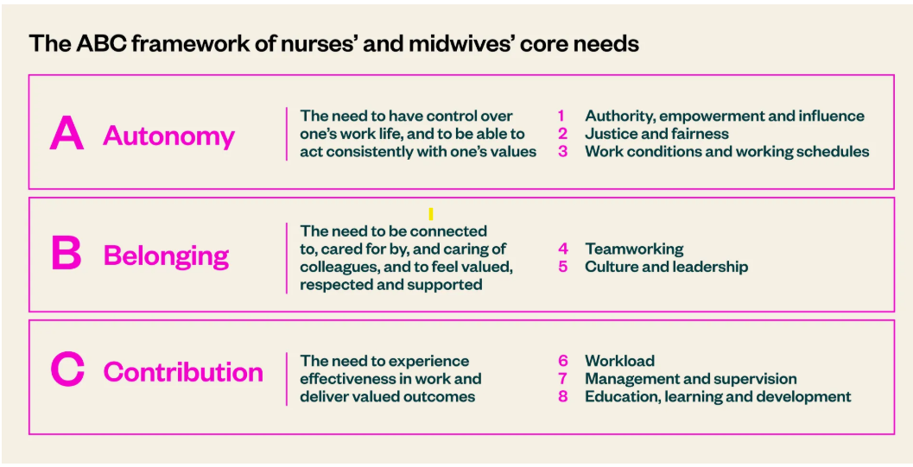
Kings Fund (2020)

Slide 11
The Challenge in Practice
How to bring it to life in our people, teams and organisations.
Creating environments where compassion can thrive, practices are needed which ‘reconnect’ people to the values and behaviours that underpin their work and values
Can you identify your own leadership style?
How far does this influence your novice leaders/students?
What mechanisms allow you to facilitate leadership recognition and discussion?

Slide 12
PA / PS and assessment in practice
Collective intelligence emerges from the collaboration of individuals.
New learning is created by people sharing their knowledge to solve problem.
Harnessing collective intelligence requires a different set of skills of leaders and managers.
They need to:
• be as skilled at finding the right questions as developing the ‘right’ solutions
• challenge the status quo, whilst being part of that system
• span boundaries, both organisationally and professionally
• Recognise failure as a necessary consequence of trying something new.
. Leadership can be demonstrated by anyone who inspires others to act

Slide 13
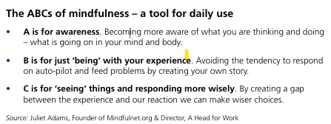
R

Slide 14
Authentic Assessment
Gill Kelly
Senior Lecturer, Specialist Community Public Health Nursing

Slide 15
Authentic Assessment
What is Authentic Assessment?
Why do we need to think about assessment being authentic?
Authentic assessment for nurse leadership
Core Components of Authenticity
Practical Strategies & Examples
Challenges & Best Practices
Action Learning

Slide 16
What is Authentic Assessment?
Authenticity is about how well the assessment correlates to the sorts of things students need to be able to do in their career after:
a) University
b) student roles / supernumary / protected learning time
Authentic assessment involves tasks that reflect real-world challenges, requiring students to apply knowledge and skills in practical contexts rather than just recalling information.
Authentic assessment is directly linked to the learning process and is therefore an integral part of practice teaching.
(Race, 2015); (Bayley, 2022); (Wu et al, 2015)

Slide 17
Why do we need to think about assessment being authentic?
Traditional methods can fail to capture the complex, relational, and ethical dimensions of learning nursing practice (Wu et al, 2015)
To bridge the gap between classroom theory and clinical leadership practice.
Nurse leadership in practice, including novice, post-registration, specialist and advanced practice is constantly changing and evolving, due to:
professional development
professional regulation
role description and job evaluation
policy

Slide 18
Authentic assessment for nurse leadership:
WHO
WHAT
WHERE
WHEN
WHY
HOW
Reflection - do you as PA and PS fully engage your students in your own leadership role, including your knowledge, skills, attributes and behaviours as a practice educator?

Slide 19
Core Components of Authenticity:
Authentic assessment must include:
Realism: Tasks need to mirror those encountered in professional life, such as resolving staff conflict or leading a quality improvement project.
Cognitive Challenge: Students must use higher-order thinking (problem-solving, critical reflection) to address "ill-defined" or complex situations.
Evaluative Judgement: Students learn to judge their own performance and others' through reflection and peer review.
Collaboration: Reflects the interprofessional nature of leadership by requiring group-work and relationship-building.

Slide 20
Authentic assessment for nurse leadership:
WHO
WHAT
WHERE
WHEN
WHY
HOW
Reflection – does your current assessment of your students’ leadership skills take account of these factors consistently?

Slide 21
Impact on Leadership Development
Implementing these assessments fosters specific leadership outcomes:
Confidence & Self-Efficacy: Authentic tasks allow students to "do" the role in a safe environment, building the confidence needed for real-world transitions.
Contextualises leadership styles:
Authentic Leadership Identity: It encourages self-awareness, relational transparency, and internalised moral perspectives – key pillars of authentic leadership.
Employability: Students reported that tasks like mock interviews or policy presentations directly improved their career readiness.

Slide 22
Practical Strategies & Examples
Scenario-Based Simulation: Using virtual simulation or reflective and restorative discussion (clinical supervision) e.g. to manage staffing crises, triage complex cases or collaborate on ethical dilemmas.
Quality Improvement (QI) Projects: Partnering with the placement area to identify a real need, develop a plan, and present findings to stakeholders.
Learning Contracts and Critical Reflection: Using e-portfolios or reflective journals to track the development of "thinking in action" and professional values.
Interactive Orals: Replacing long essays with professional conversations or "vivas" to assess real-time communication and decision-making skills.

Slide 23
Challenges & Best Practices
Time Intensity: Designing and grading these tasks takes more time than traditional tests. Solution: Use “backward design” - start with the desired leadership outcome and work backward (Jones et al, 2024); collaborate with partners to determine which leadership outcomes can be assessed authentically.
Subjectivity: Grading open-ended tasks can be variable. Solution: Implement clear, objective rubrics that are shared with students and practice partners.
Anxiety: New formats can be stressful for students and assessors. Solution: Scaffold learning by providing low-stakes formative opportunities and clear instructions before assessments are set.

Slide 24
Summary
Defining and understanding authentic assessment is a collaborative process for academic and practice assessors.
Authentic assessment is not just a way to grade; it is a learning experience itself.
By "doing" the subject, aspiring nurse leaders develop the resilience, ethical grounding, and practical competence required for modern healthcare.
Reflection on our own leadership roles is needed to be able to plan for, teach and assess leadership authentically.
Next steps: action learning

Slide 25


Action Learning
What 3 actions will you be able to take away today to engage your learners in authentic assessment of leadership?

Slide 26
Key questions to consider:
What do you want?
How will you get there?
What’s the first step?
What could get in the way?
What do you need?
When will you start?
What’s a realistic timescale?
What will you learn from that?
What works (or has previously worked) for you?
How could you change that?
What would that give you?
What does it look like from (the other person’s) position?
Who can support/assist you?

Slide 27
Thank you
Any questions?

