Slide 1

Failing Students well
Dr Paula Beesley
Senior Lecturer in Social Work
Academic Practice Lead

Slide 2
I am a big advocate of failing students
When it is the correct assessment
And when due process has been followed

Slide 3
FAIL BETTER
Ever tried? Ever failed?
No matter. Try again
Fail again. Fail better
                Beckett, 1983

Slide 4

Placement is a partnership
Both student and practice educator contribute to the development of the student’s knowledge and skills and placement outcome

Slide 5
Practice educator role
Our role as a practice educator is multi-functional.
      Educate
      Support
      Manage
      Assess
      (ESMA: Doel, 2010)
And that gives us a significant level of power

Slide 6
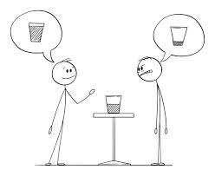
It all comes down to a matter of perspective
We are a friendly team with lots of social activities
We arranged a welcome lunch for the student and he wasn’t interested
Student experience
Practice educator experience
I’m excluded because I can’t engage in the social activities because I am a single, working mum
I’m not part of the team because I’m fasting for Ramadan and struggle around food smells

Slide 7
Practice educator perspective
Student perspective
I asked her to outline which theory she had used, but she wasn’t interested, just suggested some random theory
I’m really supportive, she choses not to open up to me
I told him where to find the resources, but he didn’t look
When I suggest a theory that I have used she says that’s not what she would have used. I feel judged and daren’t offer any more ideas
I am scared that sharing that I am finding it hard will mean I’m told I’m failing
I looked where he told me for the resources, but they weren’t there. I could see his frustration when I asked again. Eventually I found them in a different location, a colleague said they’d been moved.

Slide 8

Are we FAILing the student …

Slide 9

… When we need to reflect on our contribution?

Slide 10
Engaging students
Reflect on the importance of working in partnership with the student to support them to identify their own learning needs
Providing good quality feedback will empower students to take control of their own learning.
The Practice Educator’s role is also to help students to make use of the feedback and enhance their practice.
(Williams & Rutter, 2024)

Slide 11

Supportive learning environment
We need to establish a supportive relationship that enables the student to engage with learning opportunities, hear feedback and develop knowledge and skills.

Slide 12

How do we create a supportive learning environment?
Take a collaborative and diligent approach (Beesley, 2023)
Take a student-centred approach
Take a restorative approach
Take a relationship-based approach
Take a strengths perspective approach

Slide 13
Be proactive in understanding the student
Make time to listen to and
Acknowledge the student’s perspective and
Needs, whilst
Acknowledging the
Differences between self and student, and ensure that you take account of their
Educational and
Life experiences when reflecting on their Needs, and be aware of
Age differences when considering power differentials that impact on ability to be open and honest with you.
                The MANDELA model, (Tedam, 2012)

Slide 14
Students start placement with:
Personal experience
Professional experience
Individual learning needs
Individual strengths and areas for development
Expectations and fears
Experiences of oppression

Slide 15
Practice educators start placement with
A full caseload
A passion for developing students
Fears that they will not be ‘enough’ for the student
Expectations of the student

Slide 16
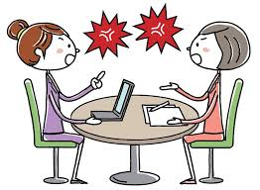
what happens when the expectations or experiences differ?
We don’t listen to each other
We start to avoid or withdraw from situations
We don’t achieve as much in the discussions
Which means students don’t develop their knowledge and skills as well

Slide 17
Students make mistakes
It is not the mistake that fails a student, but how they respond to it that passes or fails them.
Reflect on when a student made a mistake on placement with you:
If a student is open to learning from a mistake, how do you respond?
If a student is blaming or defensive, how do you respond?

Slide 18
Practice educator role
The majority of students learn from their mistake
However, students sometimes need support to help them identify where that they need to change
Reflect on what barriers might a student have that are preventing them from addressing the issues with you.

Slide 19
Barriers to change
Not ready to learn
Inadequate pre-placement learning
Student feels overwhelmed by placement
Student feels overly confident in placement
Practice Educator - student relationship
How feedback is given (and received)
(Beesley and Taplin, 2023)

Slide 20
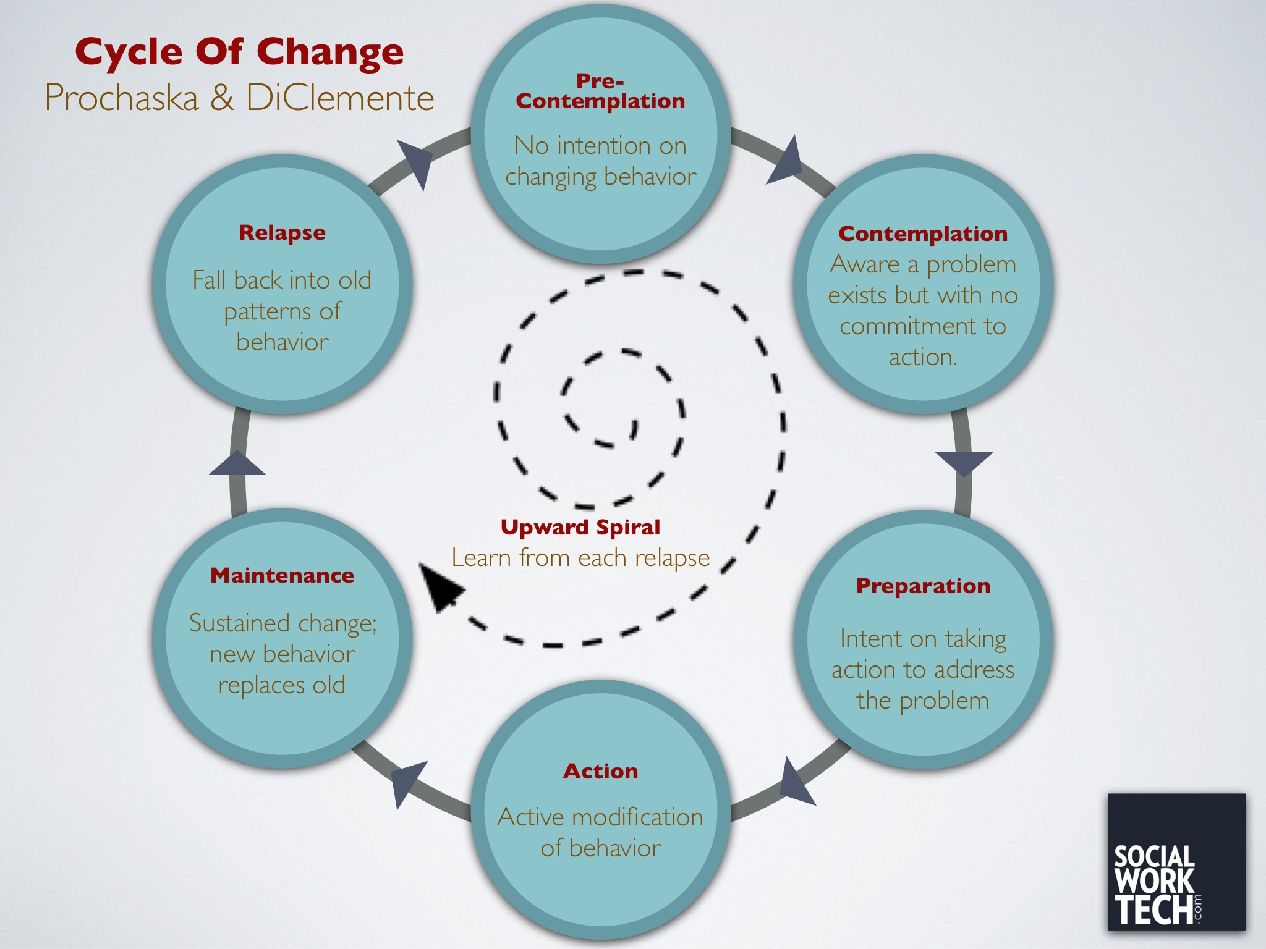
How do you help a student that does not want to change?

Slide 21
Student support
How can you support a students where there are concerns about their practice to engage in changing their practice?
Follow procedural processes
Try different approaches
Talk to colleagues
Don’t assume
Be aware of power

Slide 22
Fail Better
There are no guarantees that your student will go on to pass placement
However, they will have learnt skills and emotional intelligence from your intervention that they can carry forward into a repeat placement or future life opportunities.
They may have failed, but they have failed better

Slide 23
References
Beckett, S (1983) Worstward Ho
Beesley, P. (2023) Collaborative experiential learning in social work practice placements. Social Work Education, pp.1-16.
Beesley, P. and Taplin, S. (2023) Practice Education in Social Work. Critical Publishing.
Doel, M (2010) Social Work Placements. Routledge
Fairtlough, A., Bernard, C., Fletcher, J. and Ahmet, A. (2014) Black social work students’ experiences of practice learning: Understanding differential progression rates. Journal of Social Work, 14(6), pp.605-624.
Prochaska, J and DiClemente, C (1983) Stages and processes of self-change in smoking: toward an integrative model of change, Journal of Consulting and Clinical Psychology, 5, pp. 390–395
Tedam, P (2012) The MANDELA Model of Practice Learning: an old present in new wrapping? Journal of Practice Teaching and Learning, 11(3), pp. 60-76.
Williams & Rutter (2024) The Practice Educator’s Handbook. Sage

