Slide 1
Practice Educator Conference
BSc (Hons) Adult and Mental Health Nursing
4th March 2026

Slide 2

Agenda
Welcome and Introductions
Format for the day
Student updates from University:
The student pathways and progress towards completion
Development and enhancements to the programme
Student support/managing student assessment
Student update from practice areas
E portfolio/PAD work
Practice area updates
NMC updates/issues
Recruitment plans/ graduate progression opportunity
AOB
Date and time of the next conference

Slide 3
Pre-Registration Adult and Mental Health Nursing Course Team 2025/26
Susan Wakefield
Head of Nursing
Cohort Lead Level 4
Zahra Rahim
Academic Assessor
Academic Advisor
Sarah Thompson
Practice Learning Lead
Cohort Lead Level 6
Michelle Stephenson (Sept)
Chinyere Ihejieto (Jan)
Kathryn Waldegrave
Course Director
Non-Apprentice
Zoe Lambert
Course Director
Apprentice
Cohort Lead Level 5
Stephanie Gibson
Student

Slide 4
Course - Academic Structure
Level 4
Semester 1 |  | Semester 2
Becoming a Nursing Student (40) | Fundamentals of Nursing Science and Practice (40) | Exploring Health and Wellbeing (40)
Practice Assessments 1 (non-credit bearing)
Level 5
Semester 1 |  | Semester 2
Developing Professional Skills (40) | Application of Nursing Science and Practice (40) | Promoting Health and Wellbeing (40)
Practice Assessments 2 (non-credit bearing)
Level 6
Semester 1 |  | Semester 2
Advancing Nursing Science and Practice (40) Population Health & Wellbeing (40) Transition to Registered Nurse (40) | Population Health & Wellbeing (40) Transition to Registered Nurse (40) | Final placement Transition to Registered Nurse (40)
Practice Assessments 3 (non-credit bearing)
Notes:
Module delivery in 10 week blocks.
Year 1- Monday is university day
Year 2- Tuesday is university day
Year 3- Thursdays and Fridays are University days
Other days in the week for self directed study and occasional clinical skills, mandatory training etc.

Slide 5
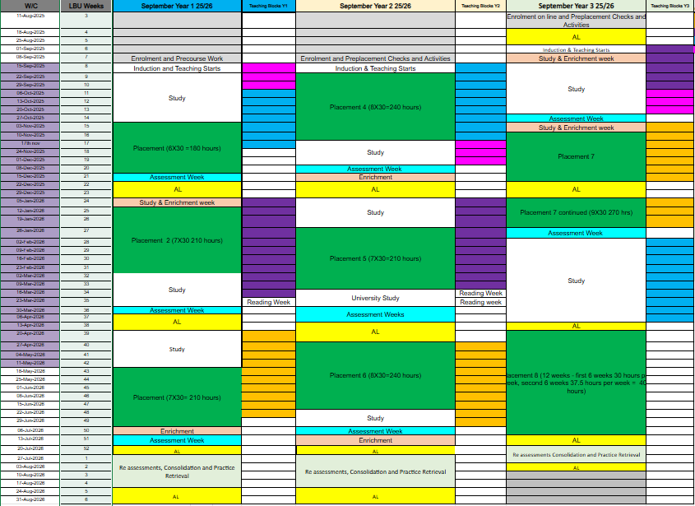
Notes:
Colour code:
Green=allocated placements
Yellow=annual leave
Peach=enrichment placement hours
Light blue=assessment weeks
Orange-Health and Wellbeing streams
Purple- Nursing Science and Practice streams
Blue- Professional and Academic Practice streams
Year 1-Level 4: 45 weeks including enrolment: allocated practice hours (600 hours), 2 enrichment placement weeks, 7 annual leave weeks
Year 2-Level 5: 45 weeks including enrolment: allocated practice hours (690 hours), 2 enrichment placement weeks, 7 annual leave weeks
Year 3-Level 6: allocated practice hours (675), 2 enrichment placement weeks, 7 annual leave weeks.
Total allocated practice hours=1965

Slide 6
40 credit Modules
Nursing Science & Practice modules
Focuses on Anatomy and physiology, pathophysiology, pharmacology, medicines management, NMC Annex A and Annex B skills
Health & Wellbeing modules
Focuses on individual, community and population health. Covers topics such as Health Promotion, Health Inequalities, Holistic person-centred Assessment, Behaviour Change, management of long-term conditions, health & social care policy drivers
Professional and Academic Practice modules
Focuses on NMC Code, professional values, behaviours and skills. Covers topics such as ethics, law, professional boundaries, communication, multidisciplinary working, developing academic skills
Notes:
X6 modules at 40 credits each=360 credits for BSc (Hons)

Slide 7
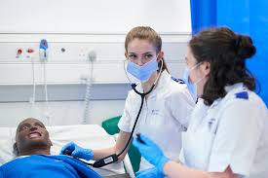
How students are taught at University
Lectures
Seminars
Application to Practice Groups sessions
Simulated Practice in Clinical Skills suite
Self-Directed study
Guest speakers
People with Lived Experience

Slide 8
Student module assessments
Nursing Science & Practice modules
Online Safemedicate exams
Online MCQ exams
3000-word Written report case study
Health & Wellbeing modules:
2.5 hour online open book exam
Narrated PPT presentation
Narrated Poster presentation
Professional and Academic Practice modules
1500-word Reflective essay
3000-word Reflective Case Study
6000-word Extended Project
Notes:
We use various assessment methods to suit students varying needs. All assessments meet quality assurance.

Slide 9
Student Support- Academic Advisor vs Academic Assessor
Academic Advisor
1-1 Support, not specific to placement
General and academic advice
Support with professional development and employment.
Will support student for the whole 3 years of study.
Academic Assessor
NMC requirement in SSSA model
Registered nurse, employed by the University (not field specific)
Coordinates liaison with Practice Assessor
Responsible for the confirmation of student placement achievement at progression points
Can’t be same academic assessor for all years
Notes:
PLFs can also support students in practice, as do PAs and PSs.

Slide 10

Practice Learning

Slide 11
Practice Assessment modules
Meet all module learning outcomes for each year
Achievement of the prerequisite hours identified by NMC in clinical practice
Practice placements assessed by a practice assessor whilst in practice
Satisfactory completion and assessment by a practice assessor of the ePAD and OAR for Pre-registration Nursing including Episode of Care, Medicines Management, Professional Values and Proficiencies.
X6 Alternative fields
225 enrichment placement hours
Min x2 patient feedbacks per year
Missed work-books EPAD and declaration
Notes:
NMC-registered nursing courses in the UK require a total of 4,600 hours over three years, split equally with 2,300 hours in theoretical learning and 2,300 hours in practice placement. Up to 600 of these practice hours can be completed through simulated learning.
X3 PAM modules over 3 year course. Non-credit bearing.

Slide 12
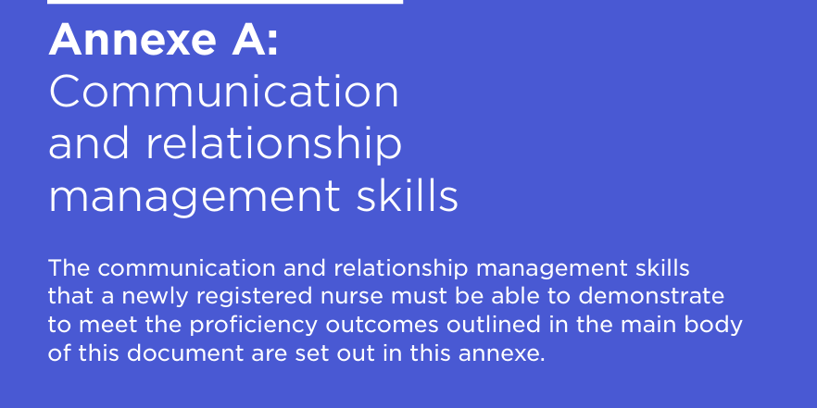
NMC Annex A Skills
https://www.nmc.org.uk/standards/standards-for-nurses/standards-of-proficiency-for-registered-nurses/
Notes:
The NMC 2018 Standards of proficiency for registered nurses Annex A details essential communication and relationship management skills required for safe, person-centred care. Nurses must demonstrate proficiency in interacting with diverse populations across all fields, including adjusting communication for disabilities and managing complex, emotional, or challenging situations.

Slide 13
Annex B Skills – University Theory & Practice
Year One
Observation taking; Aseptic technique; Injection technique (S/C, IM)
BLS, Moving & Handling, Breakaway training
Fluid balance monitoring; Nutritional assessment
Year Two
Venepuncture (lab analysis); cannulation; IV fluid management; monitoring of blood transfusion; medical device monitoring;
All Gender Urinary Catheterisation; Cardiac monitoring; 12 Lead ECG. Airway management theory; Respiratory assessment, End of life care (also at L6)
Year Three
IV administration of drugs and additives; Management of blood transfusions.
NG Tube insertion, chest auscultation,
Invasive medical device management; Airways devices; Verification of death; Blood gas interpretation
Throughout Course
Clinical key (Elsevier) Clinical Skills Platform
Safemedicate E-Learning
E-Learning for Health Mandatory Training
A-E assessments- management of a deteriorating patient
Yearly mandatory training
https://www.nmc.org.uk/standards/standards-for-nurses/standards-of-proficiency-for-registered-nurses/
Notes:
NMC Annex B (2018) details essential, evidence-based nursing procedures that registered nurses must perform safely and competently across all fields, including physical assessment, hygiene, nutrition, and infection control. It covers recognizing deterioration, managing devices, and providing compassionate, person-centred care to diverse patients.

Slide 14
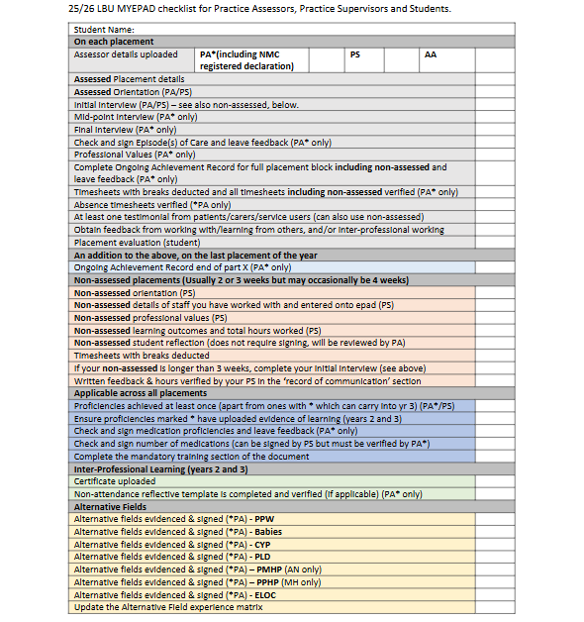
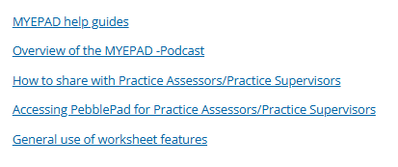
Pebblepad
Documentation
Use Checklist to support full completion-
available on Pebblepads under 'Guidance'
then 'LBU Guidance'
Links in Pebblepad for 'How to':
Notes:
Students can send PAs and PSs these links, particularly regarding sharing Pebblepads.

Slide 15
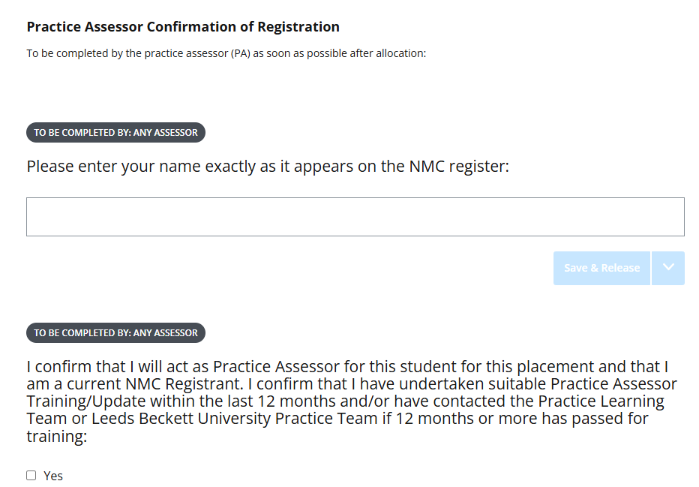
Updated Placement details section
Notes:
All PAs must complete this additional section added this year to students EPADs.

Slide 16
Co-Production working
People who have lived through challenges—such as physical or mental health issues, disabilities, or social injustice—have valuable insights that can help improve services and education. We want to make sure their voices are heard.
People with Lived Experience can learn how to get involved, via two different routes:
Support the student experience in the education and development of our future healthcare professionals. Find out more information by viewing ‘The Student Experience’ section below.
and/or
Become involved in relevant active research that informs future health and social care.
Public and Patient Involvement and Engagement
Notes:
We have a new PPI website where people with lived experience can apply to work with us toi support curriculum delivery for all of our apprentice and non-apprentice students.
Lived experience experts (previously known as Service Users) can get involved in many ways throughout the SoH- teaching, curriculum design, evaluation, research etc.

Slide 17
Absence reporting
Students have a clear process for reporting absence which involves informing University AND the placement area. They are advised if they cannot contact the placement, to contact the Practice Learning team at the University
They are also advised to contact their Academic advisor
If they do not attend placement and haven’t notified you, please do report to our practice learning team.

Slide 18
Health and Social care Practice Learning Hub
Health and social care practice learning hub

Slide 19
Practice area updates- Now time for questions and discussion!
Notes:
Now, it is time to hear from you. We have a few questions that we would like you to consider and discuss as a group.

Slide 20

Practice area updates
What challenges do you experience when supporting students in practice?
What learning opportunities are you able to access?
How do you support students in practice with reasonable adjustments?
How are you supported in practice?
How can we support you to support our learners in practice?
What do you know about the West Yorkshire ICB Placement Strategy?
https://www.wypartnership.co.uk/publications/icb-placement-strategy

Slide 21
Practice area updates
How are students supported in practice to complete Annex B proficiencies?
What possible challenges do you experience with placement documentation/PebblePad?
How do you support students with placement adjustment plans?
How do you ensure students and assessors complete documentation before end of placement?
What gaps in knowledge have you identified in practice?
What are the strengths of LBU students in practice?

Slide 22
NMC Updates
NMC updates:
NMC: Reviewing nursing and midwifery practice learning
NMC updates:
NMC: Code and revalidation reviews
Notes:
The NMC is now seeking Council approval to consult on several key changes to education standards. These include for nursing education:
Reducing the requirement for 4,600 programme hours, while maintaining a balance of 50% theory and 50% practice learning – instead, specifying a minimum of 1,800 hours for each (3,600 hours total)
Adding a new requirement that students should have a practice learning opportunity within a community setting across health and social care
Exploring whether to introduce a maximum use of simulated practice learning (proportionate to the number of practice learning hours if reduced).

Slide 23
Co-Production working
BSc Adult Nursing and Mental Health Nursing Course is supported by People with Lived Experience through:
Recruitment
Teaching and learning
Course development
Course delivery
Course evaluation
School of Health Patient, Public and Involvement (PPI) website:
LBU SoH Public and Patient Involvement and Engagement
Notes:
We have a new PPI website where people with lived experience can apply to work with us toi support curriculum delivery for all of our apprentice and non-apprentice students.
Lived experience experts (previously known as Service Users) can get involved in many ways throughout the SoH- teaching, curriculum design, evaluation, research etc.

Slide 24
Recruitment/Progression
UCAS applications: 112 UCAS points required:
https://www.leedsbeckett.ac.uk/courses/adult-nursing-bsc/
https://www.leedsbeckett.ac.uk/courses/mental-health-nursing-bsc/
Apprentice routes (Nursing Associates, BSc Adult & Mental Health Nursing)
LBU Post Registration Courses (PG Cert, PG Dip, MSc)
Leeds RCNI Careers Fair: 17th March 2026 (https://www.careersandjobsfair.com/leeds-2026)
Notes:
Post Gard courses: Advanced Clinical Practice, Non-Medical Prescribing, Community Specialist Practitioner-District Nursing, Specialist Community Public Health Nursing- Health Visiting, Specialist Community Public Health Nursing- School Nursing, Health and Community Care, Public Health-Health promotion.
The Leeds RCNi Nursing Careers Fair is on 17 March. Our face-to-face nursing careers event is completely free to attend and will offer your students the opportunity to speak to nurse employers who will be offering career advice on the day.

Slide 25
Next Conference Dates
Our next Educator Conferences will be November 2026 (on campus) and will be via MS Teams in March 2027 with details found at:
Health Practice Learning Hub- Nursing & Healthcare Placements

Slide 26

Thank you

