Slide 1
Practice Assessor Conference 8th November 2023
Lisa White & Andrew Winterburn

Slide 3
Contact Details
Lisa White
Senior Lecturer / Program Lead in Advanced Clinical Practice, School of Health
Leeds Beckett University, CL916, Calverley Building, City Campus, Leeds, LS1 3HE
Email: l.white@leedsbeckett.ac.uk
Tel: 0113 812 7399
Andrew Winterburn
Degree Apprenticeship Assessor Post-Registration courses. School of Health.
Leeds Beckett University, Portland Building,City Campus, Leeds LS1 3HE
Email: andrew.winterburn@leedsbeckett.ac.uk
Tel: 0113 81 27612

Slide 4
Agenda
ACP program of study
Assessment / Portfolio
Apprentices
AOB
Date & time of next conference

Slide 5
Advanced Clinical Practice MSc modules
Advanced Health Assessment
Complex Health Conditions
Non-Medical Prescribing
Understanding Social Research
Professional Development
Research in Practice (dissertation)
End Point Assessment (apprentices only)

Slide 10
Assessment
Formative & summative
OSCE’s
Assignments
Portfolio

Slide 12
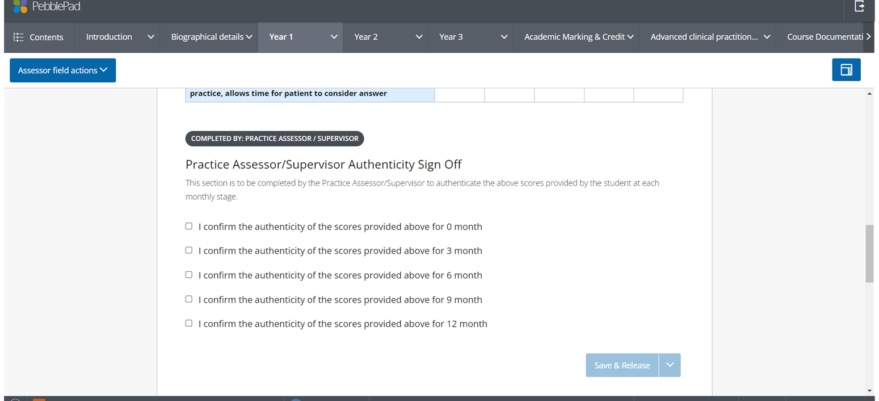

Slide 15
Tripartite Review Meetings
Essential component of the apprenticeship.
Meetings involve the Apprentice, you as the Employer/Practice Assessor and Apprenticeship Assessor.
Between 30 and 60 minutes long.
Opportunity for Apprentice and Employer to ask any questions, give feedback and raise any concerns.
The Apprentices chance to share progress with you, share updates they have including any concerns and discuss support available to the Apprentice moving forward. It is also the chance for you to record how you think the Apprentice is progressing in work and on the program.
Objectives / Actions /Targets will be set to review at the next meeting, so think about what the Apprentice needs to achieve alongside the portfolio requirements.

Slide 16
TPR Agenda – during the meeting we might cover things like this:
Review Progress
Bank achievement against assignments, and discuss progress at work
Review progress against objectives as agreed at previous review meeting
Review progress towards the predicted date for EPA
Review Compliance Elements
Is the Apprentice getting enough time in the working week to complete the required learning? Are the total hours on track?
Agree any action needed
Address any planned absences or change of circumstances likely to impact on progress
Identify any additional or adapted learning support needed
Ensure that the off-the-job learning requirement is met
Address any issues or barriers impacting upon performance
Enable further development against the knowledge, skills and behaviours in the apprenticeship
Create an action plan, objectives, timeline and allocate responsibilities that will:
Check attendance – 100% required.
Review all parties’ views of progress to date against the KSBs and elements in the Commitment Statement, noting results: e.g. assessment grades, module completion
Check submission timeliness .
Check the activity log – is this up to date and accurate? Is it referencing the KSBs linked to the learning undertaken in University, at work and self-directed?
Check for any additional support needs and if a plan already exists, whether this is effective and if it needs to change for the forthcoming modules
Check and discuss understanding of the apprenticeship ‘core curriculum’ – such as British Values, Safeguarding and Careers
Set objectives between Apprentice and Employer
Discuss any barriers or issues impacting on progress and how to resolve those (including any additional support needed)
Check that off the job learning and on the job learning are keeping pace with each other and agree any ‘at work’ learning by you as the employer
These are the sorts of thing you and your Apprentice should be reflecting on, noting on the form and preparing to discuss ahead of the meeting.

Slide 17
Apprenticeship Hours
Total hours for the standard Apprenticeship should be 1804 +.
Each 20 credit module is approx. 200 hours. Non-Medical Prescribing is 40 credits therefore 400 hours. Exemptions (RPL) for modules will reduce the total hours accordingly.
At least one Study Day and one Supernumerary Clinical Practice day per week. Two study days during Non-Medical Prescribing.
These ‘off the job’ hours need to be recorded on the Apprentice Activity Log and uploaded to Aptem every month. The hours will be discussed in Tripartite Reviews. KSBs should be referenced for all University, self-directed and clinical practice learning.
You can view Activity Logs on Aptem to ensure new learning is being achieved, especially during clinical practice days when the Apprentice may be at a placement opportunity or during self-directed learning periods.

Slide 18
Aptem
You and your Apprentice must utilise the Aptem system on a regular basis for:
uploading activity logs (monthly),
tripartite meetings including contribution before the meeting and signing after the meeting,
Viewing progress
Viewing upcoming components and timelines
EPA including the Gateway meeting and signing all paperwork
Please contact aptem@leedsbeckett.ac.uk or apprenticeships@leedsbeckett.ac.uk if you have any technical problems with Aptem.

Slide 19
Save the date!! Next Practice Assessor Educator Conference Wednesday 6 March 2024.

