Slide 1
Students or Apprentices: what is the difference?
Wednesday 5th November 2025
Facilitated by: Laura Brown, Jayne Wade and Andrew Winterburn
Degree Apprenticeship Assessors

Slide 2

Agenda
Welcome and Introductions
Courses that Leeds Beckett University offer
Route to Qualification
Padlet: Question 1 and Discussion
Language
Regulators
Support available from the University and Employers
Padlet: Question 2 and Discussion
Benefits of Supporting and Supervising Apprentices
Padlet: Question 3 and Discussion

Slide 3


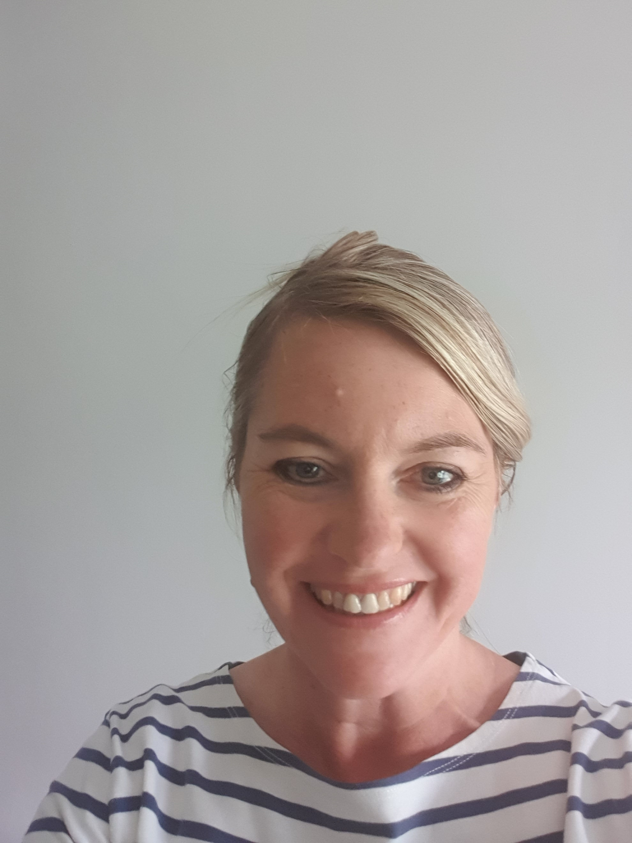
Welcome & Introduction
Laura Brown
Degree Apprenticeship Assessor
Andrew Winterburn
Degree Apprenticeship Assessor
Responsible for:
FdSc Nursing Associate
Responsible for:
MSc Advanced Clinical Practice
Jayne Wade
Degree Apprenticeship Assessor
Responsible for:
FdSc Nursing Associate

Slide 4
Courses that Leeds Beckett University offer
Apprenticeships | Standard Route
BSc (Hons) Adult Nursing | BSc (Hons) Adult Nursing
BSc (Hons) Mental Health Nursing | BSc (Hons) Mental Health Nursing
FdSc Nursing Associate | BSc (Hons) Health and Community Care
PGDip Community Specialist Practitioner (District Nursing) – Level 7 running out | MSc Advanced Clinical Practice
MSc Advanced Clinical Practice – Level 7 running out | MSc Health and Community Care
 | PGDip Community Specialist Practitioner (District Nursing)
 | PGDip Specialist Community Public Health Nursing - Health Visiting
 | PGDip Specialist Community Public Health Nursing – School Nursing
 | Post Reg CPD inc. NMP, Infection Prevention etc.

Slide 5
Route to Qualification and Employment Status
Standard Route: 50% classroom (theoretical and practical teaching) and 50% practice clinical placements over 36 months.
Upon completion, 91.1% of BSc (Hons) Adult Nursing graduates are either in work or undertaking further study 15 months after graduation. NMC approved.
Apprenticeship: Full-time, employed throughout the course. Paid for study and off the job learning so knowledge and skills can be utilised in the workplace for benefit of all. NMC, ifATE and Ofsted approved.

Slide 6

Padlet Question 1:
Thinking about your experience of apprenticeships so far, what has worked well or, if you could, what would you like to change?
Please submit your answer by scanning this QR code (your post can be made anonymously)

Slide 7
Language
Onboarding vs. UCAS Admissions
Self Funded vs. Employer and Government Funded Levy
Hub / Spoke / Enrichment
Supernumerary / PLT / Protected Learning Time
Off the Job Learning
Tripartite Meeting and Activity Logs
KSBs and NMC Proficiencies
Gateway Meetings
End Point Assessment (EPA)

Slide 8
Regulators
Nursing and Midwifery Council (NMC)
Office for Students (OfS)
Department for Education
Education and Skills Funding Agency (ESFA)
Institute for Apprenticeship and Technical Education (ifATE)
Ofsted

Slide 9
Support Available from University and Employers
Employers
NHS Trust Libraries
University
Academic Advisors
Work Based Learners Team
Clinical Educators, Practice Education Team
Occupational Health
Employee Assistance Programme (EAP)
Academic Assessors
Degree Apprenticeship Assessors
Student Support
Disability Services
University Library

Slide 10

Padlet Question 2:
How do you tailor the support and guidance that you provide to apprentices?
Please submit your answer by scanning this QR code (your post can be made anonymously)

Slide 11
Benefits of supporting apprentices
Bring knowledge and skills back to the hub
Identify new ways of working
Opportunity to share best practice
Opportunities for learners to undertake hub specific projects
Build relationships with other departments

Slide 12

Padlet Question 3:
How do you integrate the learning your apprentices have gained on placement and incorporate this into your ward/department’s future working practices?
Please submit your answer by scanning this QR code (your post can be made anonymously)

Slide 13

Thank you
Any questions?

