Slide 1
Student Services Disability Advice, Support Worker Service Study Resources
How to decode your assignment

Slide 2
How to decode your assignment
Step 1
Read the task and instructions

Slide 3
Source: Auckland University of Technology

Slide 4
How to decode your assignment
Step 2
Look for key words

Slide 5
Source: Auckland University of Technology

Slide 6
Source: Auckland University of Technology

Slide 7
Source: Auckland University of Technology

Slide 8
How to decode your assignment
Step 3
Check meanings of instruction words

Slide 9
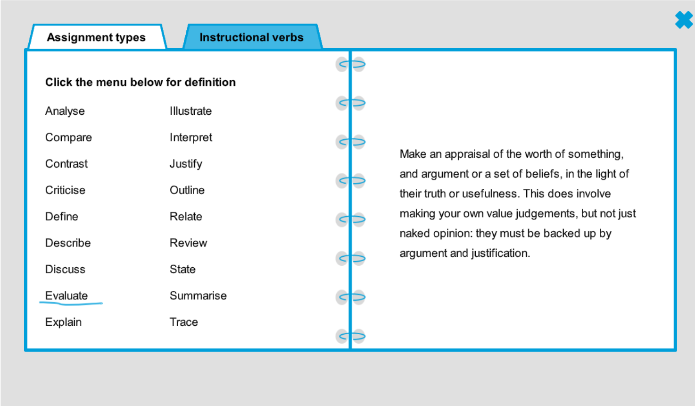
Source: University of Leeds

Slide 10
Consider using a template

Slide 11
Need more help?
Use these links to get more help on decoding your assignment http://www.phrasebank.manchester.ac.uk/ https://libguides.hull.ac.uk/ld.php?content_id=32587072

Slide 12
Contact Details:
supportworkerservice@leedsbeckett.ac.uk
disabilityadvice@leedsbeckett.ac.uk

