Slide 1
Leeds Beckett University Disability Assessment Centre
Study Needs Assessment
What should I expect?

Slide 2
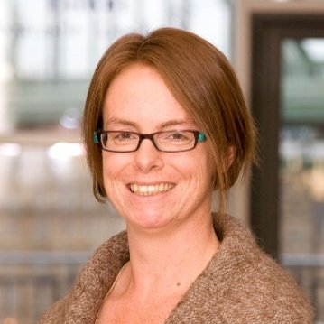
Who will I meet?
Sharon
Access Adviser and Study Needs Assessor
T: 0113 812 3357
E: dac@leedsbeckett.ac.uk
Disability Assessment Centre G01 Priestley Hall Headingley Campus Leeds Beckett University Leeds LS6 3QS
Notes:
Script
“Hello my name is Sharon and I am the Access Adviser you will be meeting at your Study Needs Assessment appointment.
You may also meet Kirsty, our Assessment Centre Administrator, Kate our other Access Adviser and Kate, The Assessment Centre Manager.
If you have any access requirements or preferences to enable you to fully participate in the assessment please do let us know, using the contact details shown on this slide. It is very important to us that you are able to express your views and opinions so that we can ensure you get the most out of this process and that the recommendations we make are appropriate to your individual requirements.”

Slide 3
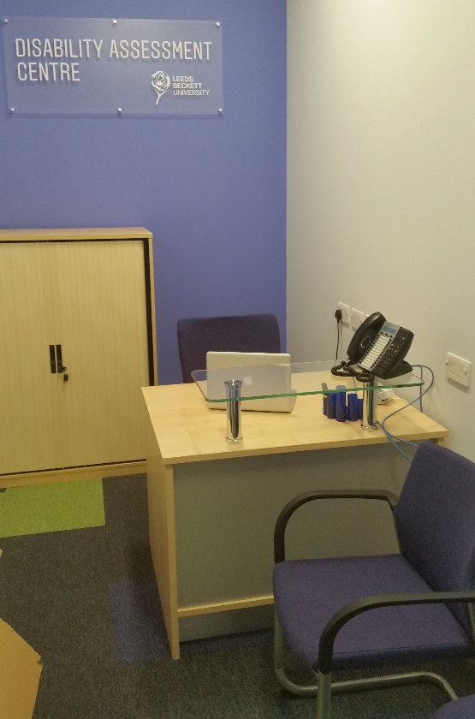
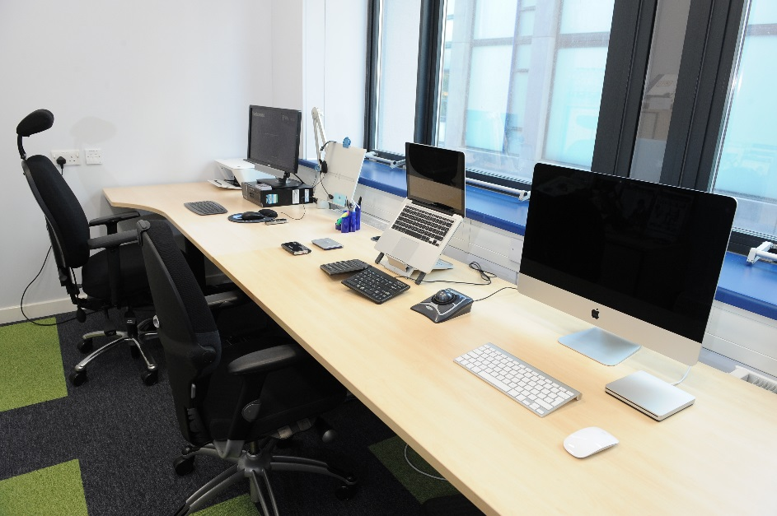
Where will we meet?
Calverley Building
Room CL118
Notes:
Script
“We will meet at the City Campus, Calverley Building. When you arrive for your assessment you can wait in our reception area. I will collect you and take you next door to the room where the assessment will take place.”

Slide 4
What is a Study Needs Assessment?
The assessment is a 1:1 discussion with an Access Adviser and Study Needs Assessor
The meeting will last for approximately 2-3hrs
During our discussion we will aim to identify appropriate support strategies and reasonable adjustments to enable you to fully participate in University life
Notes:
Script
“The study needs assessment tends to be a structured but fairly informal 1:1 discussion with an Access Adviser and Study Needs Assessor which will usually last between 2 and 3 hours. You will have the opportunity to talk about strategies you have already developed and support you have found useful in the past as well as exploring any additional support that is available to you throughout your degree programme.”

Slide 5
What will we talk about?
Introduction
Your disability and the information you have provided prior to your assessment
Your course, each area of your study and any impact your disability has on the way you learn.
The specialist support and equipment available to you at University.
Notes:
Script
Firstly, I will introduce myself, offer you a drink and try to ensure you are comfortable in the environment.
I will then check your personal details and explain to you what will happen during the assessment.
We will talk about your Disability, your previous education or employment experiences and any support you have found useful. We will also talk about the information you provided us with prior to your assessment (e.g. Educational Psychologists Assessment Report and/or Medical Evidence) and your pre-assessment questionnaire.
It may be helpful for you to think about support you have found useful during previous studies or in the work place and/or challenging experiences you have had and any help or support you think could have helped you at the time.
We will then talk about the course you have chosen to study and each area of your study in depth in order to identify any impact your disability is likely to have on the way you learn. You should think about any difficulties you might have in the following situations:
Researching
Accessing the library
Identifying appropriate reading material
Reading, decoding, processing and retaining information
Composing Assignments
Interpreting assignment questions
Planning written work
Expressing your thoughts and ideas in writing
Proofreading
Identifying errors in spelling, grammar and structure
Knowing how to correct errors
Note Taking
Attending taught sessions
Multitasking, reading, listening and writing at the same time
Speed and legibility of handwriting
Time Management and Organisation
Attending appointments and taught sessions
Keeping track of deadlines and key pieces of information
Estimating how long tasks are likely to take & managing your study time accordingly
Organising files, notes and handouts
Examinations
Communication and Social Interaction
Communicating with University Staff
Communicating with your peers
Group work
Delivering presentations
Placements and/or practical tasks
Mobility and Travel
Travel between home and University
Travel in and around university
Travel to placement/study visit
Physical access requirements
We will then talk about the specialist support and equipment available to you at University, I will show you some of the assistive software and equipment, and in some cases you may also be able to try it out.”

Slide 6
What types of recommendations might be made?
This could include any or all of the following:
non-medical help (human) support such as 1:1 mentoring or study skills support
specialist equipment
general allowance (i.e. photocopying, printing)
recommendations relating to teaching and learning
Notes:
Script
“Recommendations for support will depend on your individual circumstances and must be considered in relation to the DSA regulations and guidance. Recommendations will vary from person to person, depending on their course, their disability and the impact their disability is likely to have on their studies.
During the assessment you will have the opportunity to ask questions or suggest strategies or equipment that you feel you may benefit from. I will discuss these with you, along with any other support or adjustments I think would be appropriate and beneficial for you.
This could include some human support, usually delivered on a 1:1 basis, such as mentoring or study skills support. Specialist equipment or assistive technology, such as mindmapping software to assist in planning your work, text to speech software to assist you in reading and processing information and proofreading your work and dictate software to assist you in composing your work. Some links to examples of the available software are included at the end of this presentation, should you wish to look at them before your appointment.
I may also make recommendations for your course team and University Disability Adviser to consider, such as, examination recommendations, extended library loans or ensuring you are provided with handouts prior to classes.”

Slide 7
What happens next?
A Study Needs Assessment Report will be produced
Copies will be sent to you, your funding body and with your permission, your University Disability Advice team.
Notes:
“I will write your report and a copy will be sent to you within 10 working days, we will also send a copy to your funding body and with your permission, your University Disability Advice team.
I will talk to you in more detail at the appointment about what you should expect to happen after your appointment and I will give you some information to take away with you.”

Slide 8
We’re looking forward to meeting you at your appointment but if you have any questions in the meantime or if you would like some further information please do contact us.
T: 0113 812 3357
E: dac@leedsbeckett.ac.uk
Disability Assessment Centre G01 Priestley Hall Headingley Campus Leeds Beckett University Leeds LS6 3QS

Slide 9
Some examples of the most common pieces of assistive software we may look at in your Study Needs Assessment can be found on the following links:
Mindmapping software
Inspiration: http://www.inspiration.com/
Mindview: http://www.matchware.com/en/products/mindview/
Text to Speech/Read Aloud software
Text Help Read and Write: http://www.texthelp.com/UK
Claro: http://www.clarosoftware.com/
Dictate software
Dragon: http://www.nuance.co.uk/dragon/index.htm

